Slide 1
Report 06/08/2020
P. Hacker

Slide 2
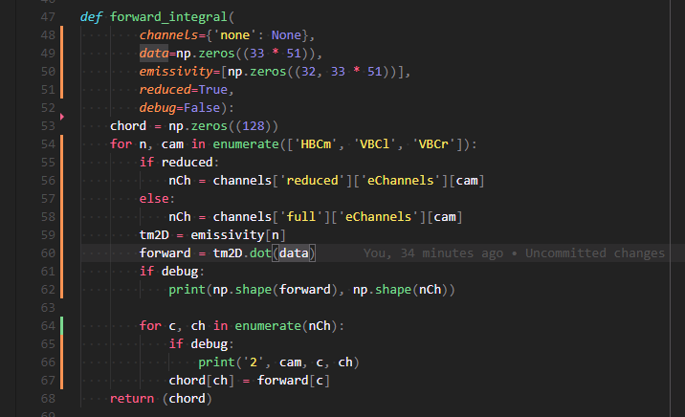
Improvement on Reconstruction and Chordal Profiles
forward and backward calculation now using the emissivity matrices themselves, instead of channel geometries individually, hence calculating directly to and from the tomogram/phantom
comparing to input chordal profiles rather than archived ones
also found error in channel selection and mapping that cause restrictions to zero where no data has been provided or excluded
deleted broken and unusable channels from script

Slide 3
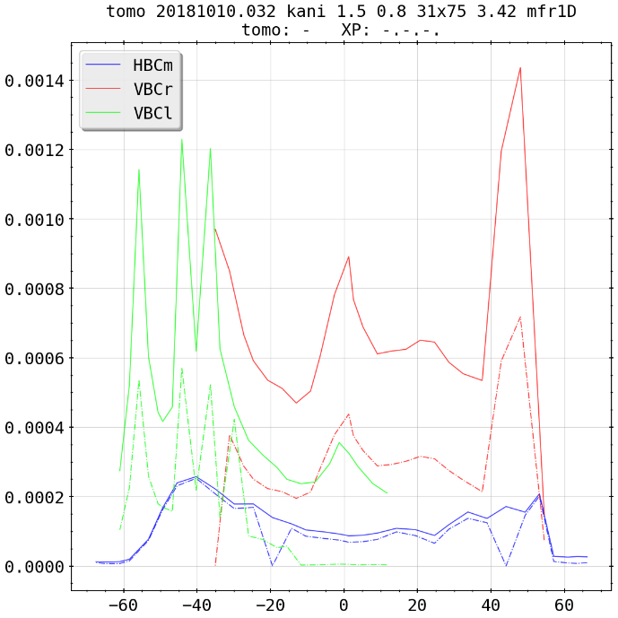
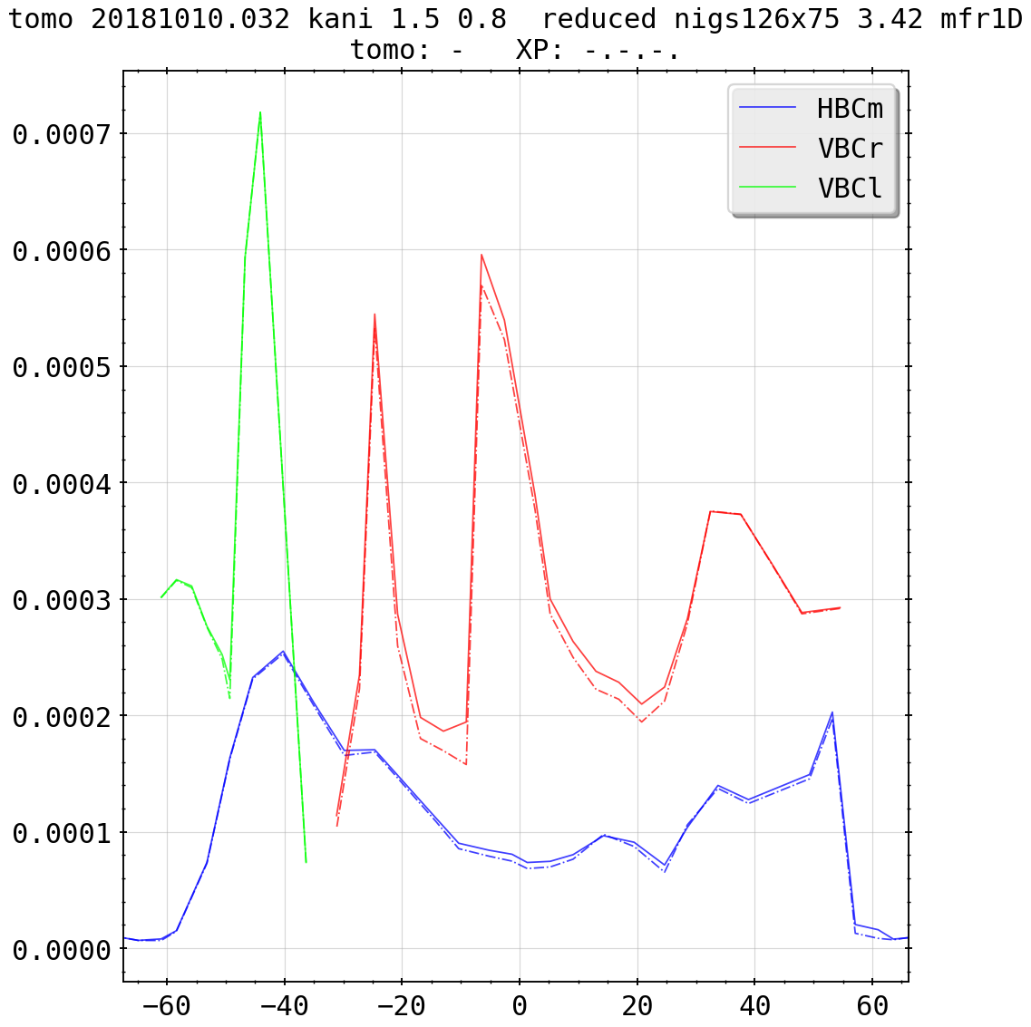
Improvement on Reconstruction and Chordal Profiles
(previously)
(current)

Slide 4
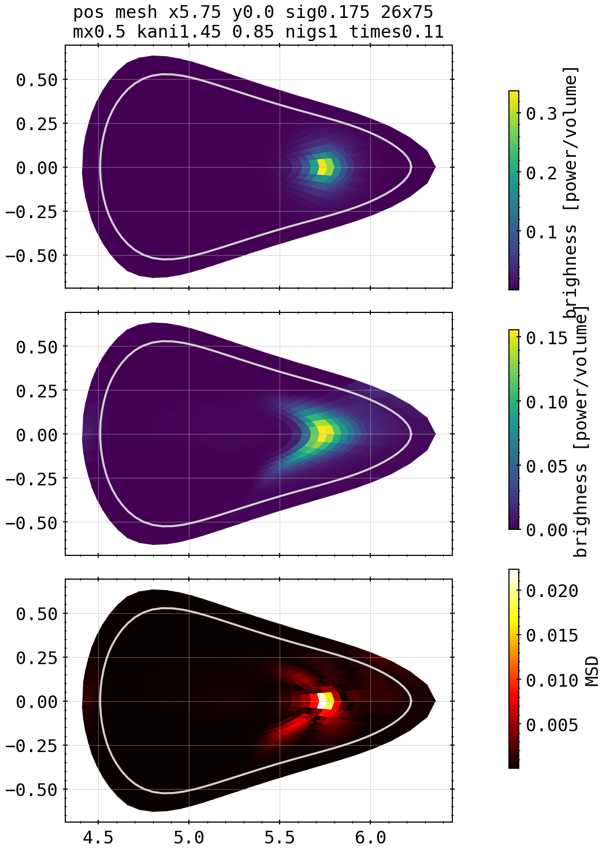
Revisiting: Phantom Tests with Anisotropy Tests
forward and backward calculation from and tomogram/phantom with MSD (mean square deviation) error and Χ² measurement
for different phantoms and same geometry scanning the core and edge weighting factor for emissivity matrices

Slide 5
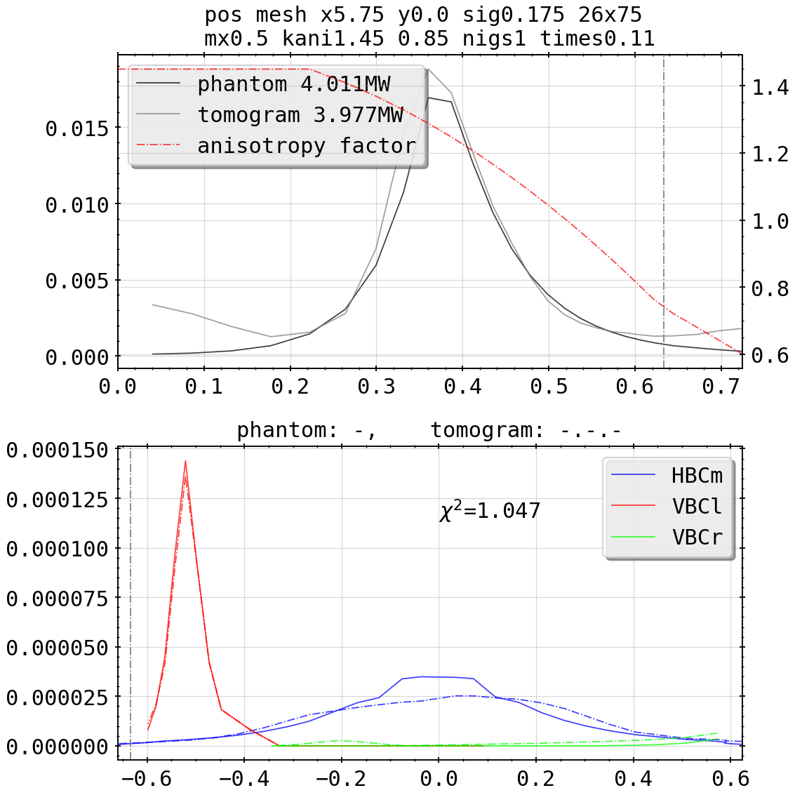
Revisiting: Phantom Tests with Anisotropy Tests
forward and backward calculation from and tomogram/phantom with MSD (mean square deviation) error and Χ² measurement
for different phantoms and same geometry scanning the core and edge weighting factor for emissivity matrices
evaluating X², MSD for every test individually, aiming for best reconstruction of the phantom

Slide 6
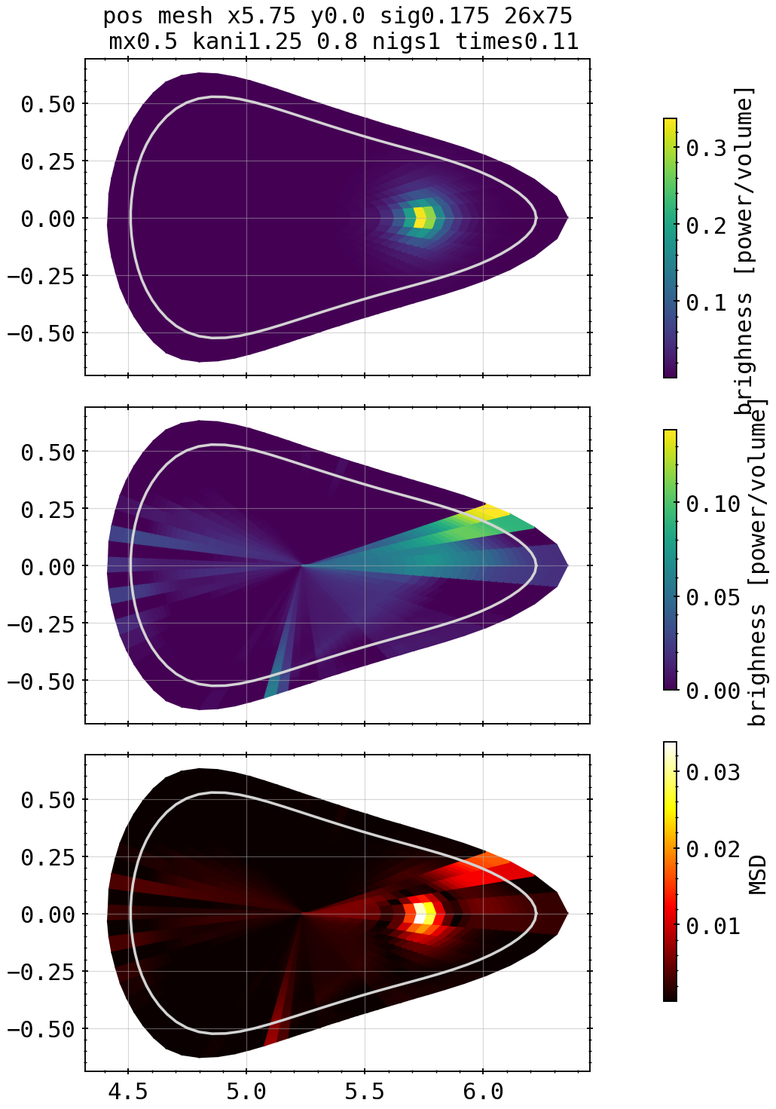
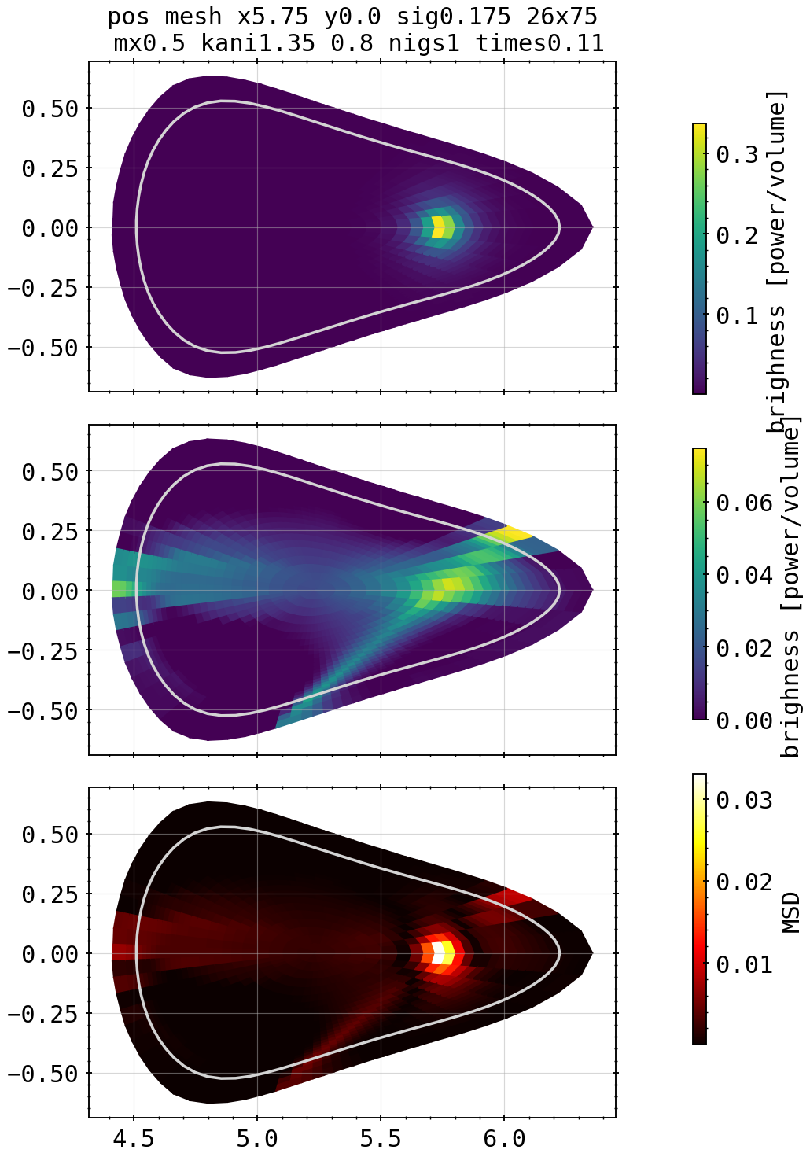

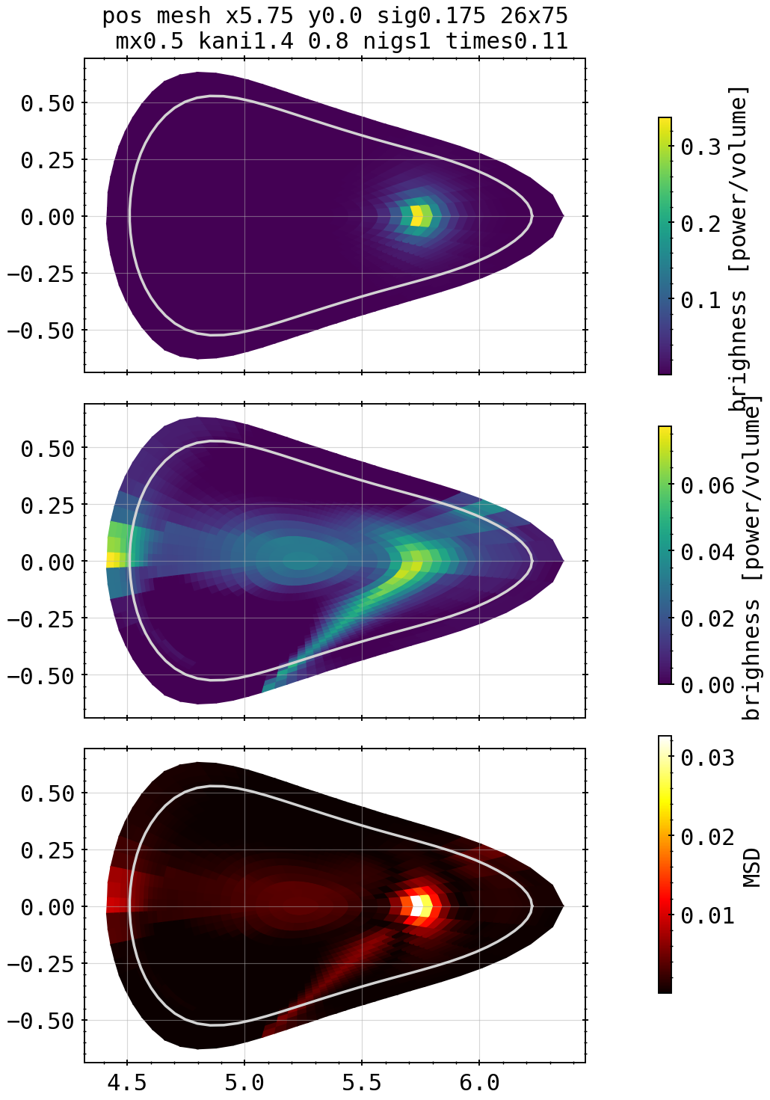
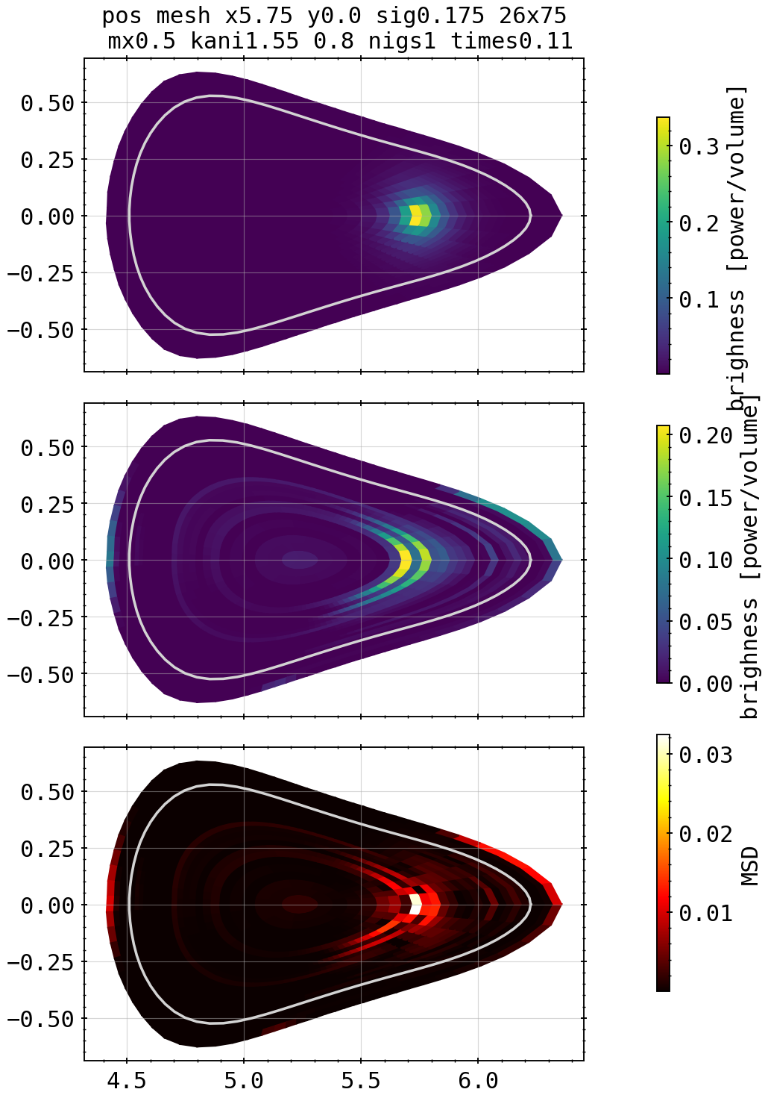
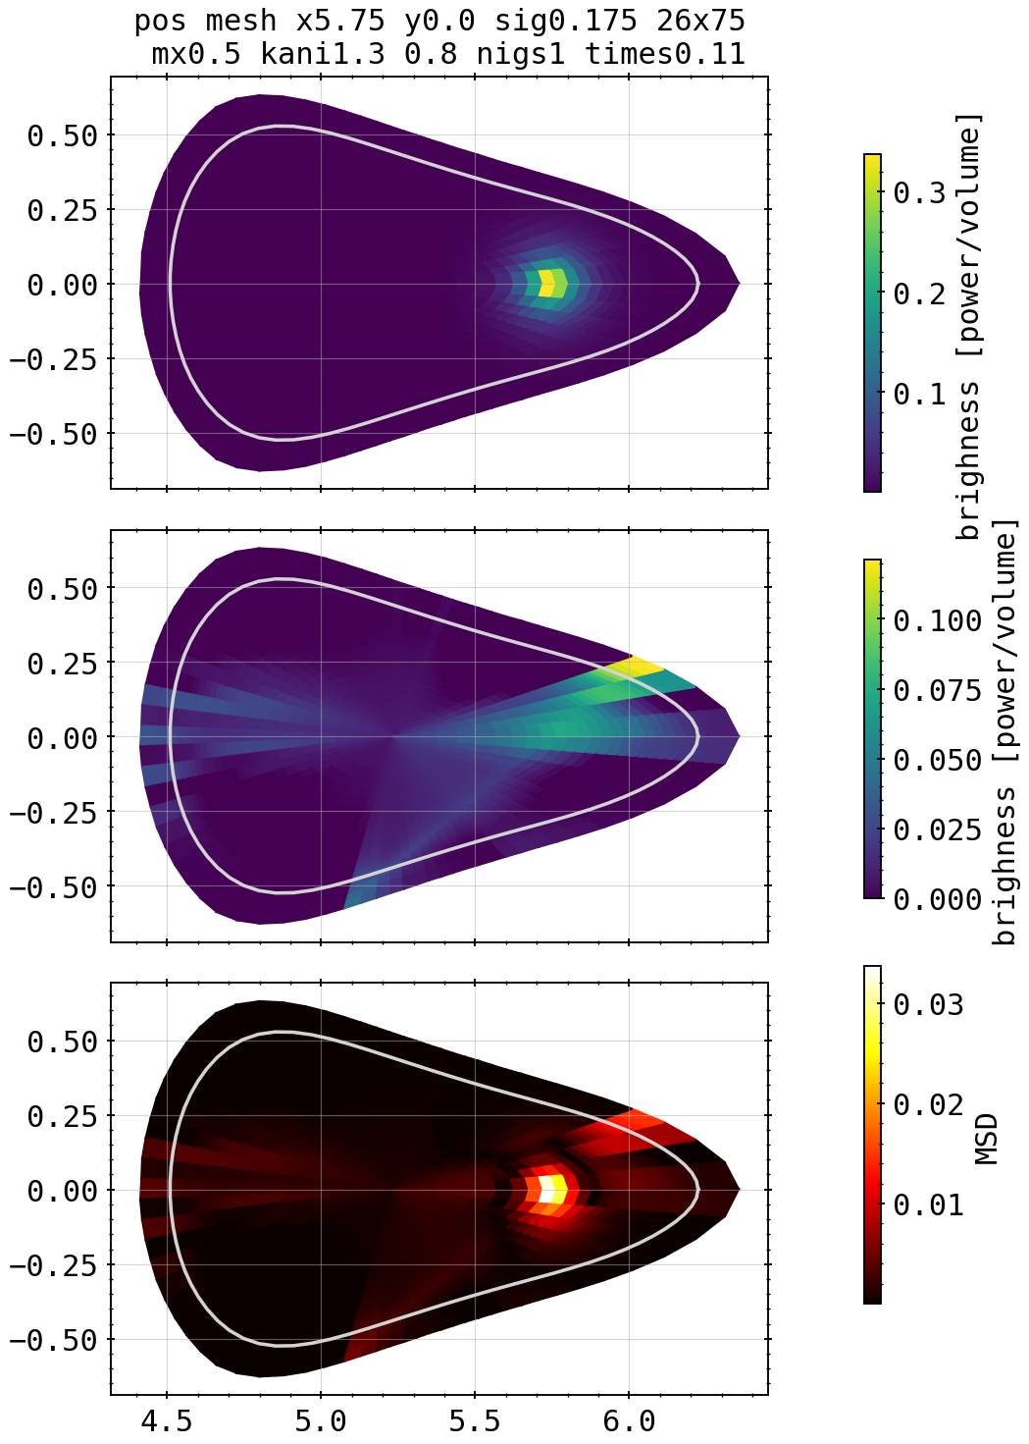
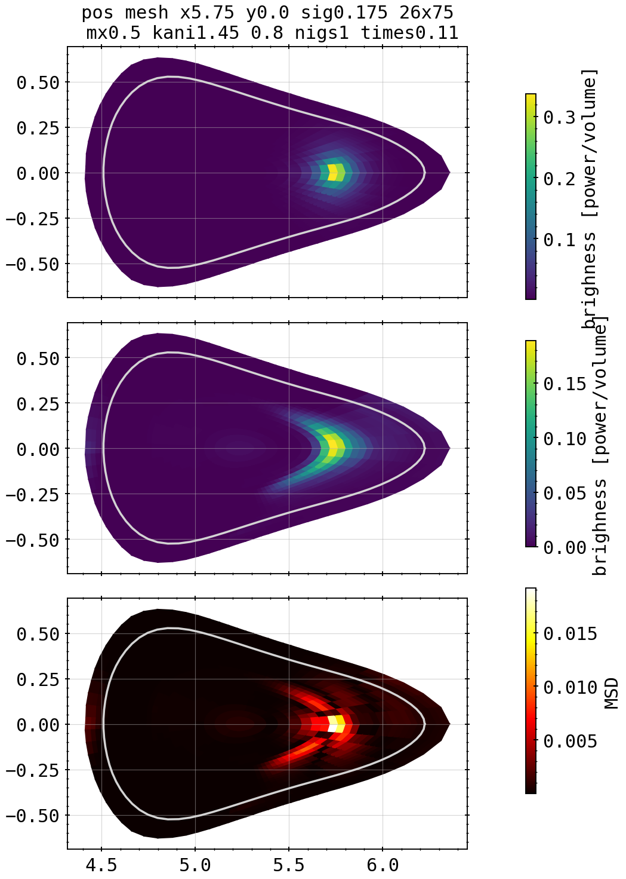
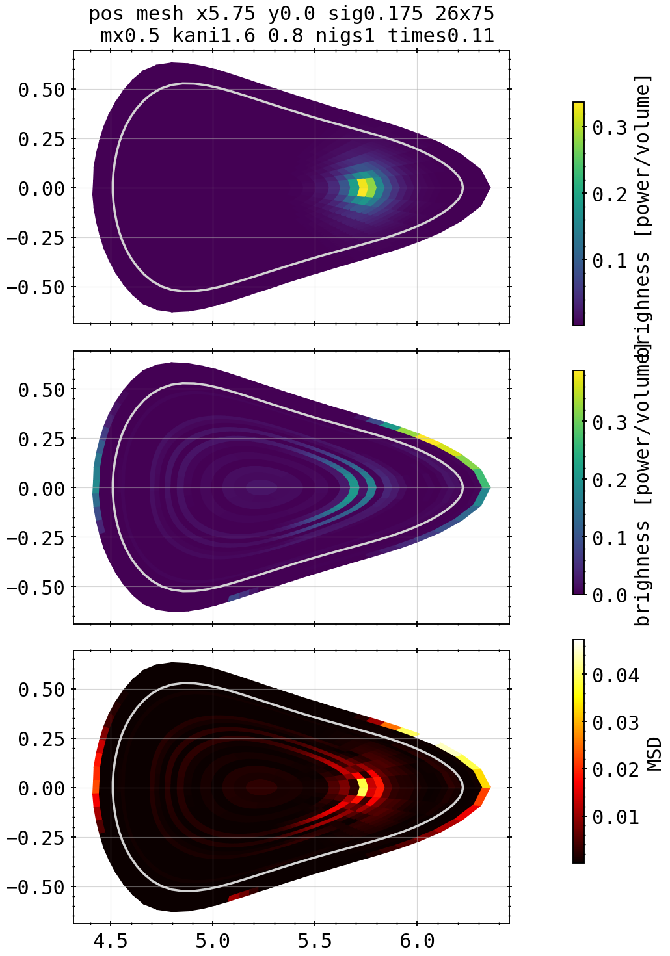
Phantoms: Asymmetric Spot Core Scan
1.35
1.5
X²=8.83
X²=1.43
Kcore=1.25, kdiff=0.8
1.4
1.55
X²=13.6
X²=12.27
X²=2.0
1.3
1.45
1.6
X²=8.0
X²=1.094
X²=6.98

Slide 7
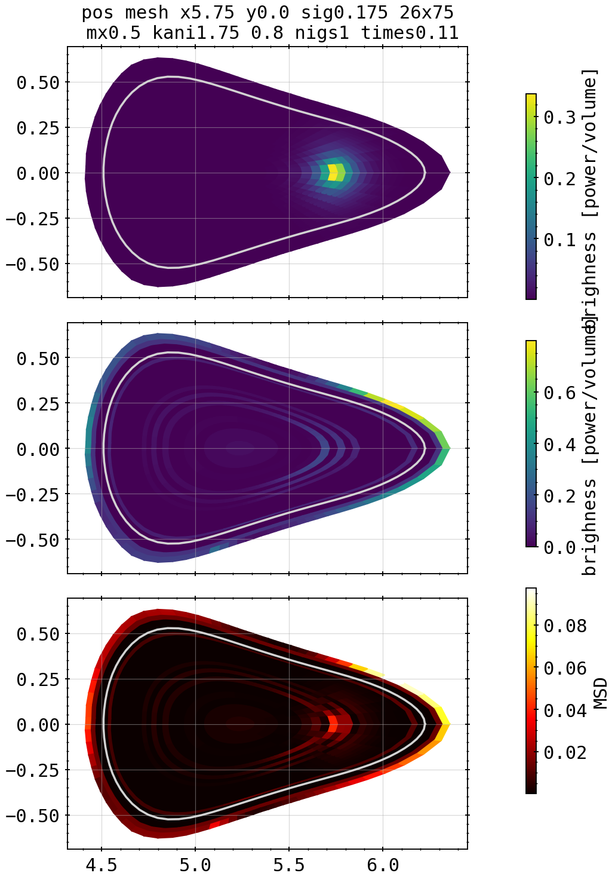

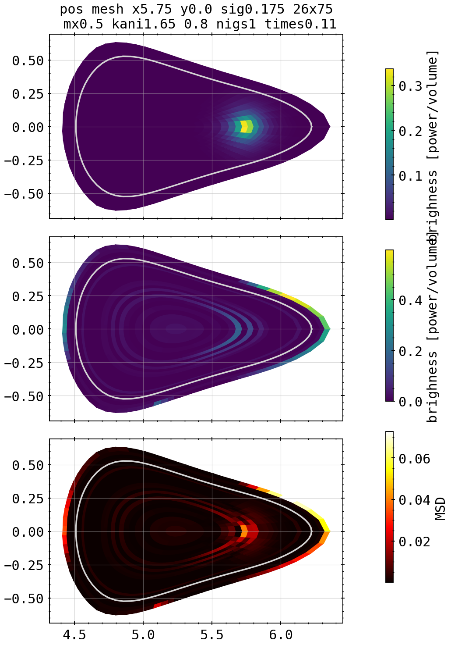
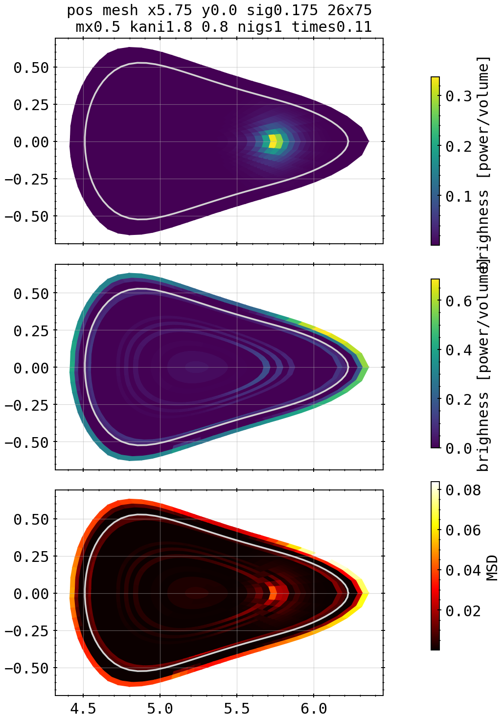

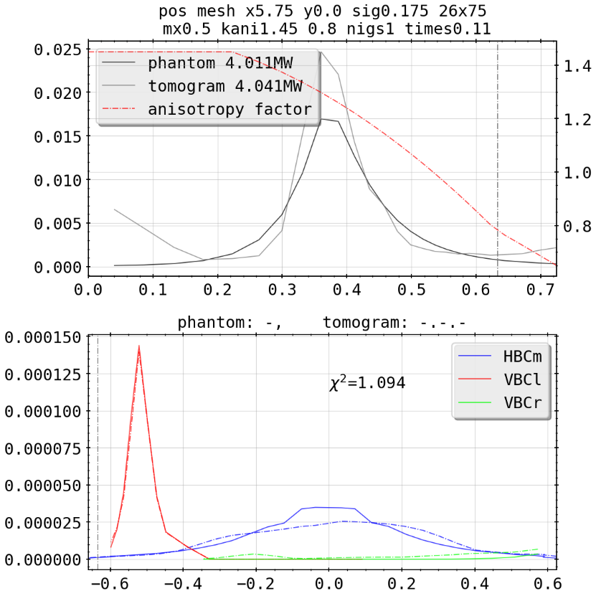

Phantoms: Asymmetric Spot Core Scan
1.75
X²=180.9
1.65
1.8
X²=28.75
X²=317.9
1.7
X²=82.28

Slide 8
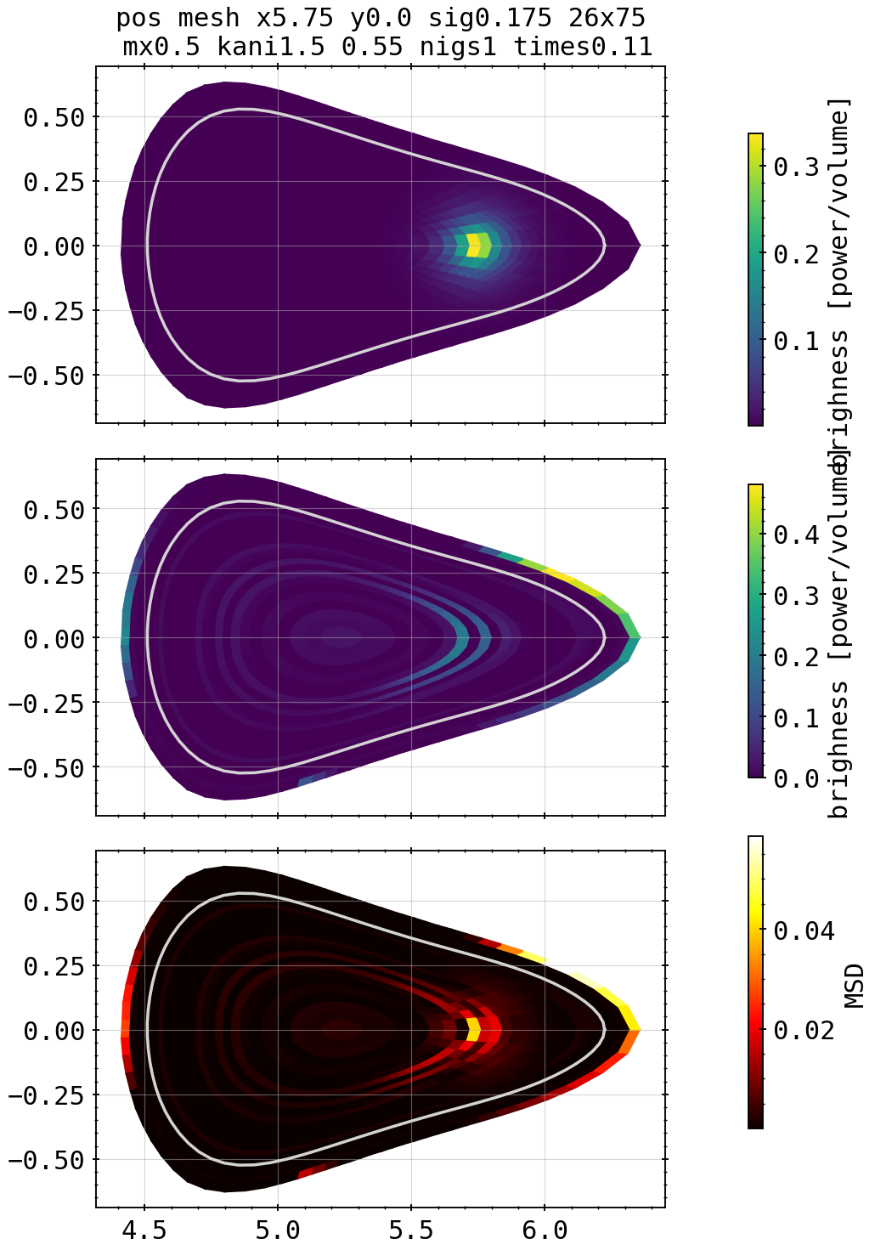
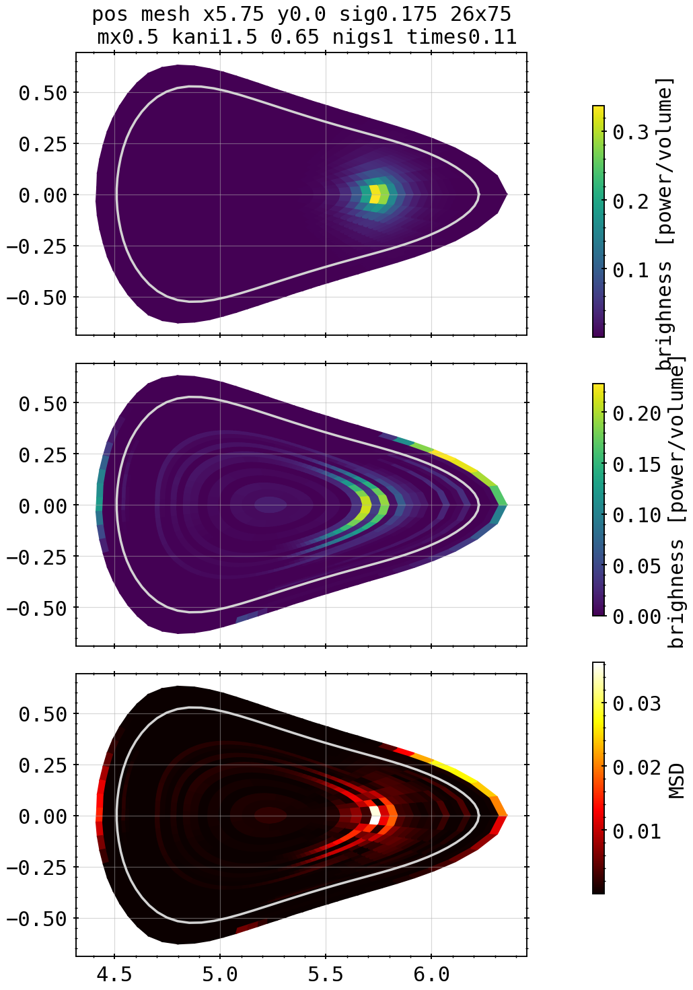



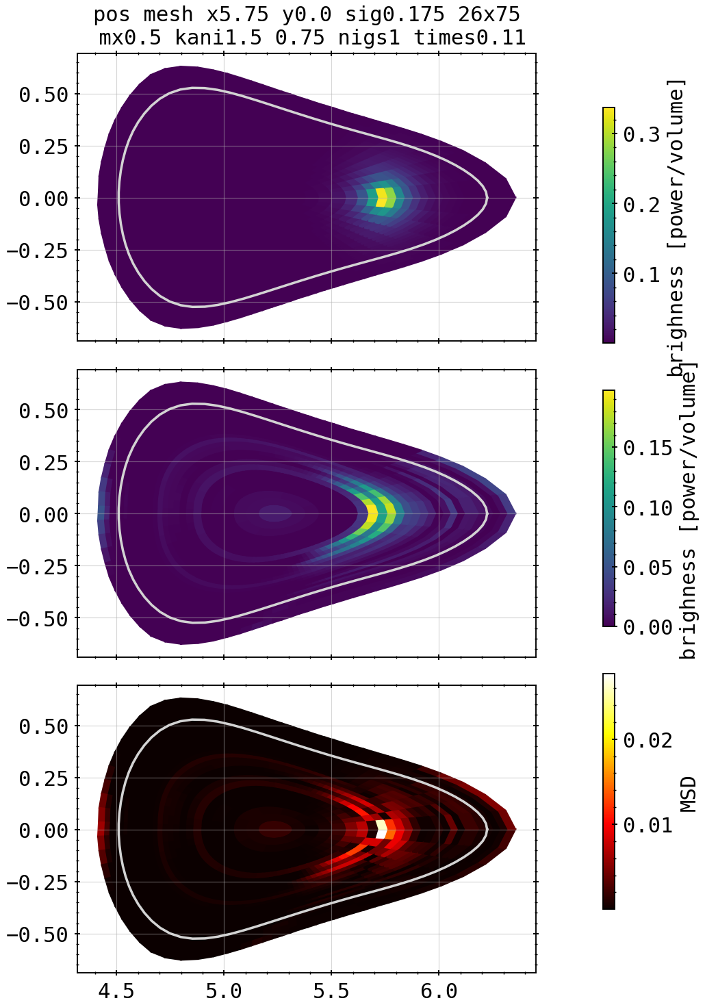
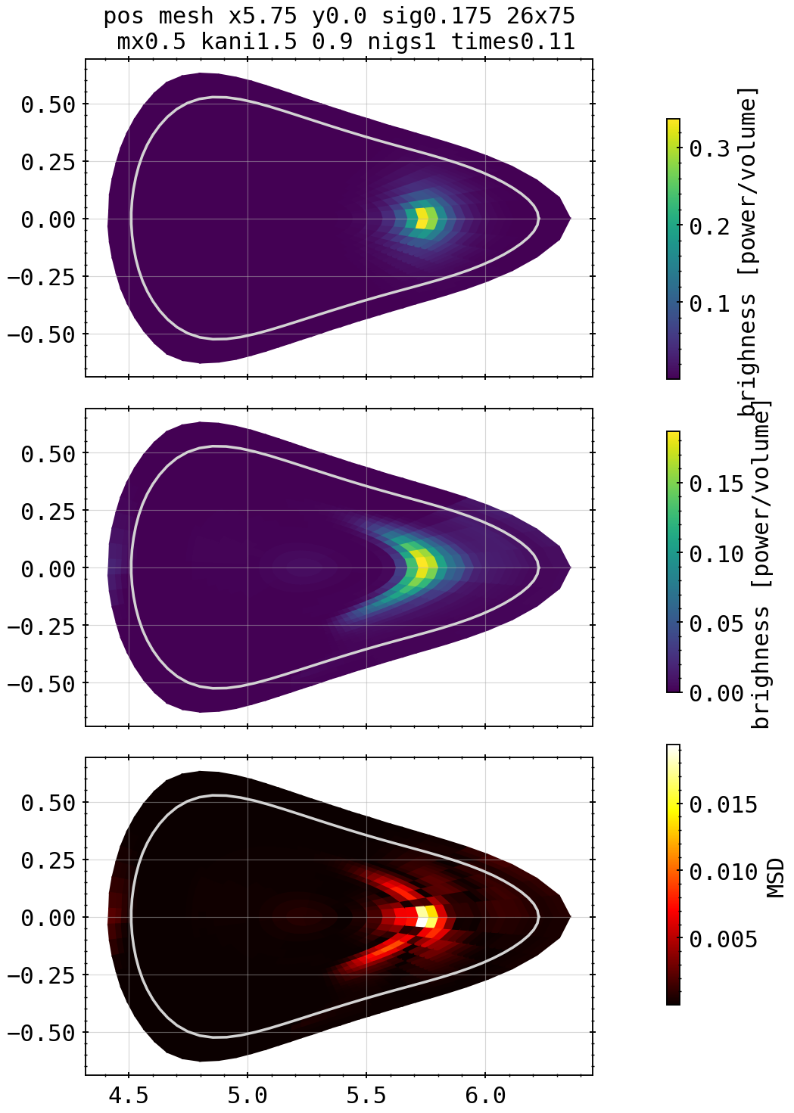
Phantoms: Asymmetric Spot Edge Scan
0.65
0.8
X²=3.01
X²=1.43
Kcore=1.5, kdiff=0.55
0.7
0.85
X²=11.63
X²=1.99
X²=1.27
0.6
0.75
0.9
X²=6.58
X²=1.69
X²=1.09

Slide 9




Phantoms: Asymmetric Spot Core Scan
1.05
X²=10.07
0.95
X²=1.04
1.0
X²=11.7

Slide 10
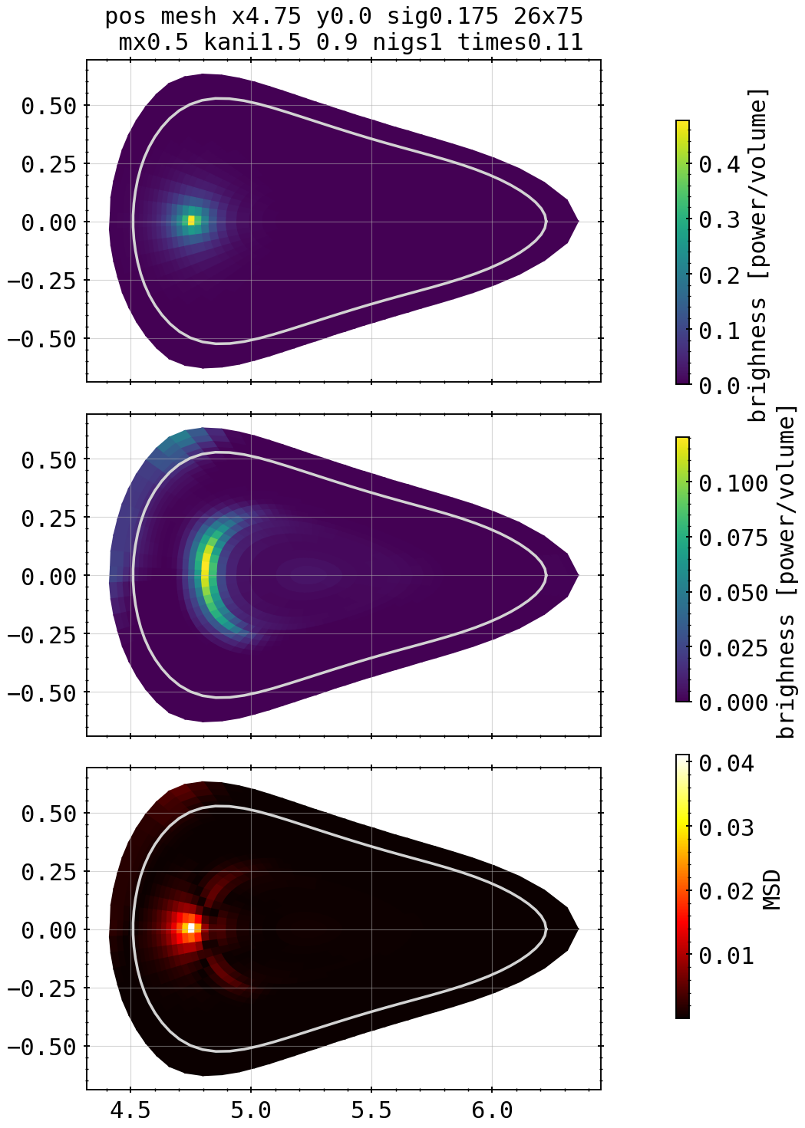
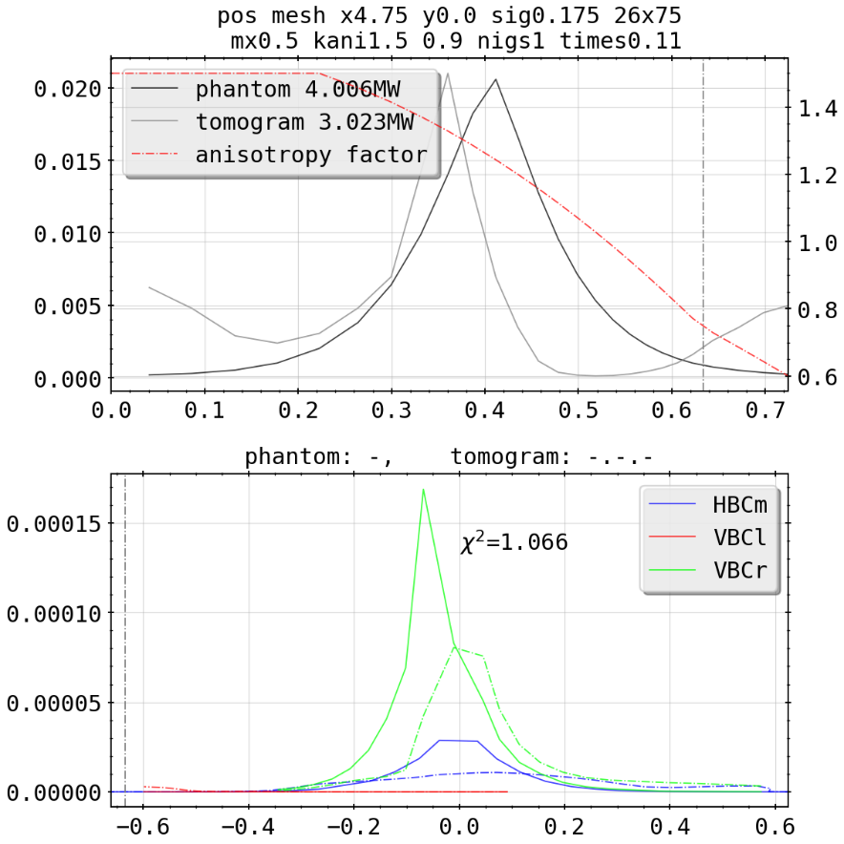
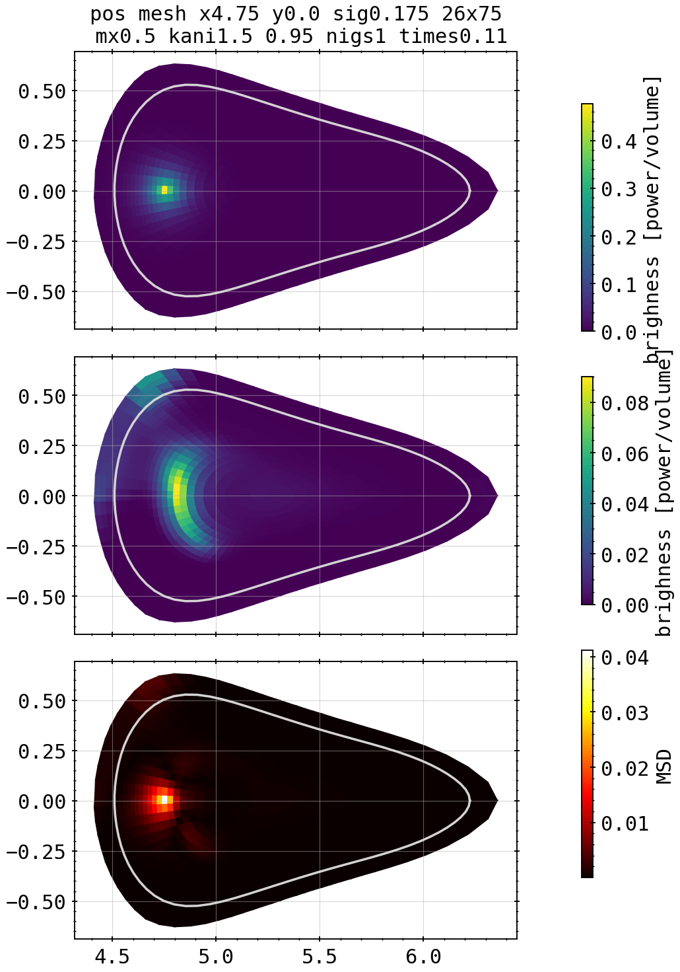
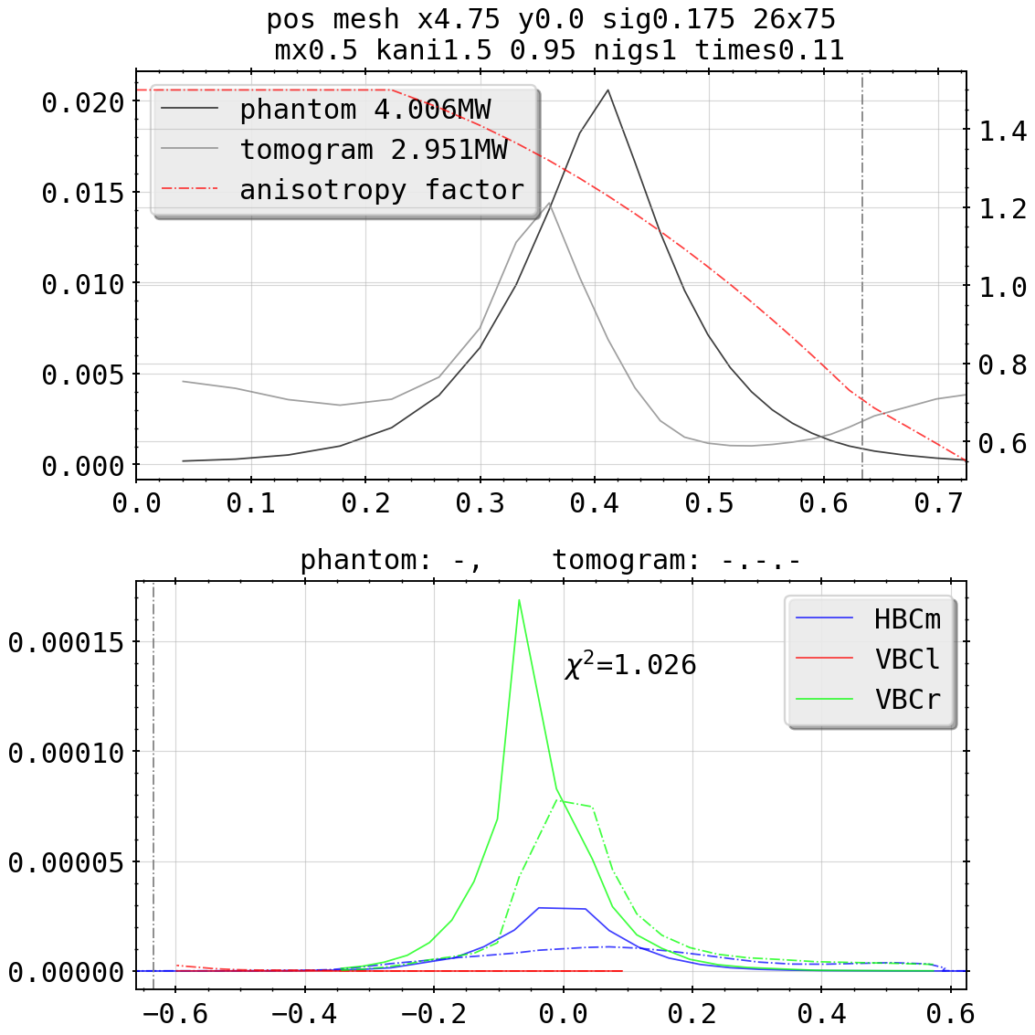
Phantoms: Asymmetric Spot (Flipped) Edge Scan
0.95
X²=1.03
Kcore=1.5, kdiff=0.9
X²=1.07

Slide 11
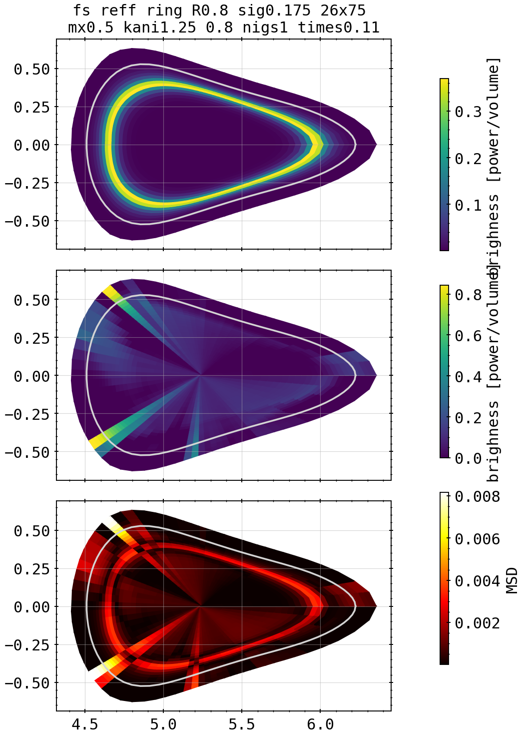
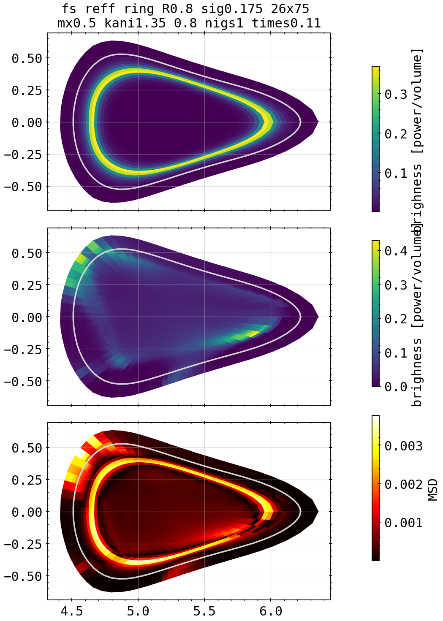
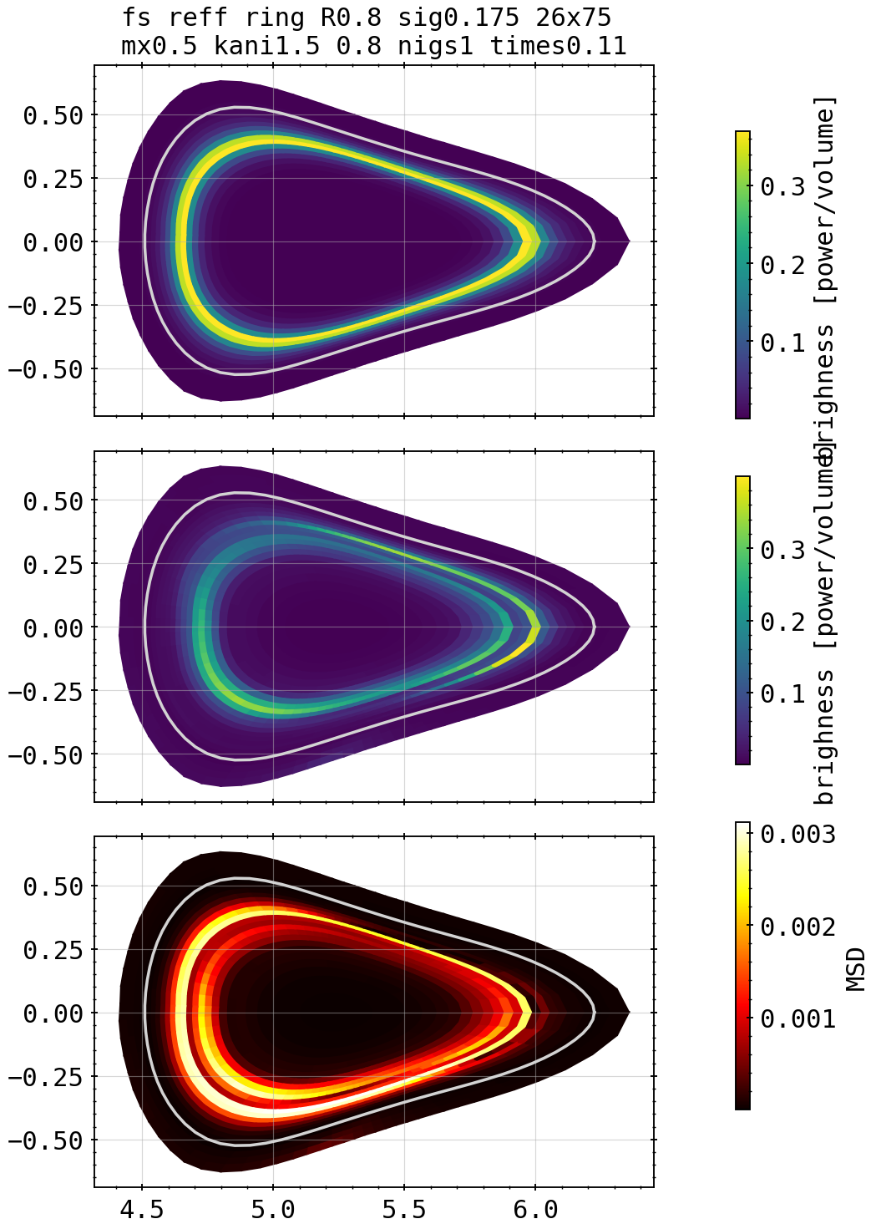
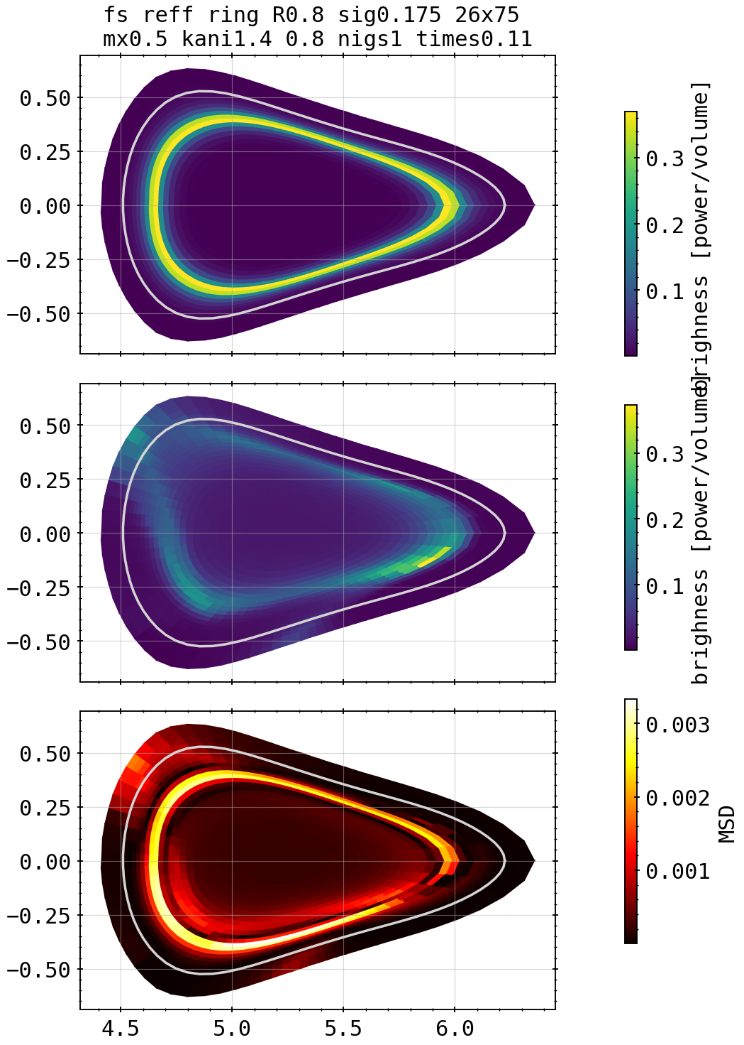

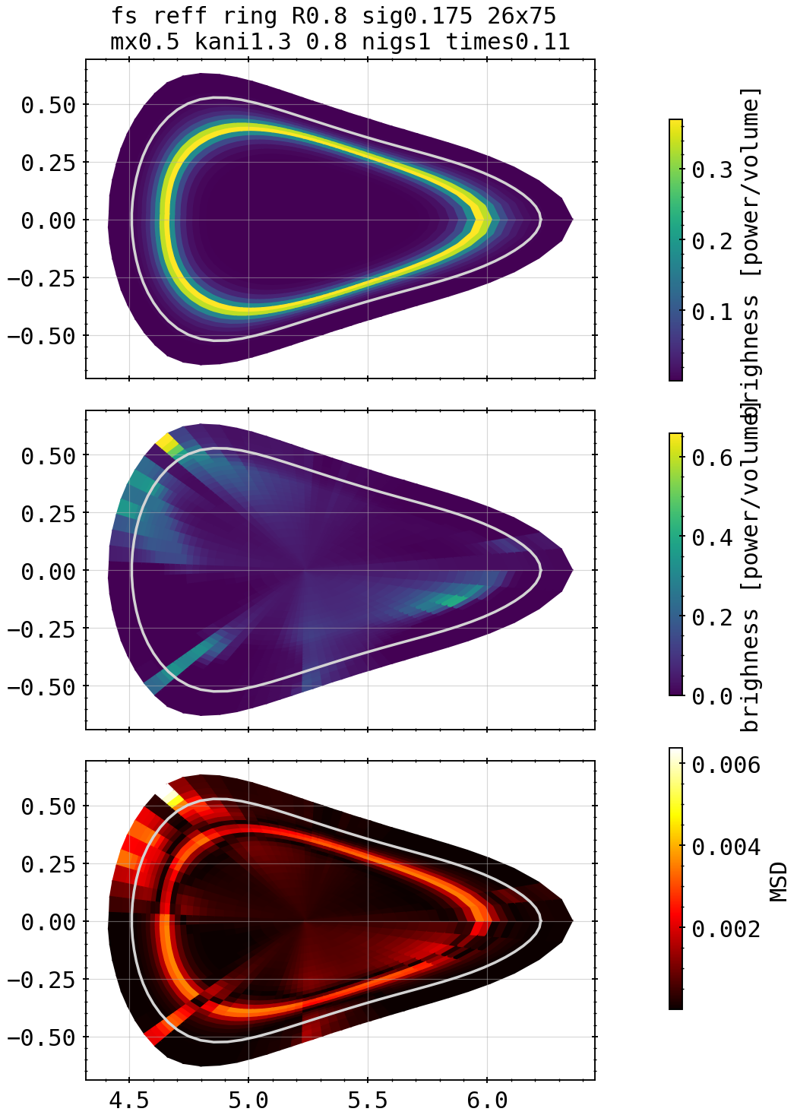
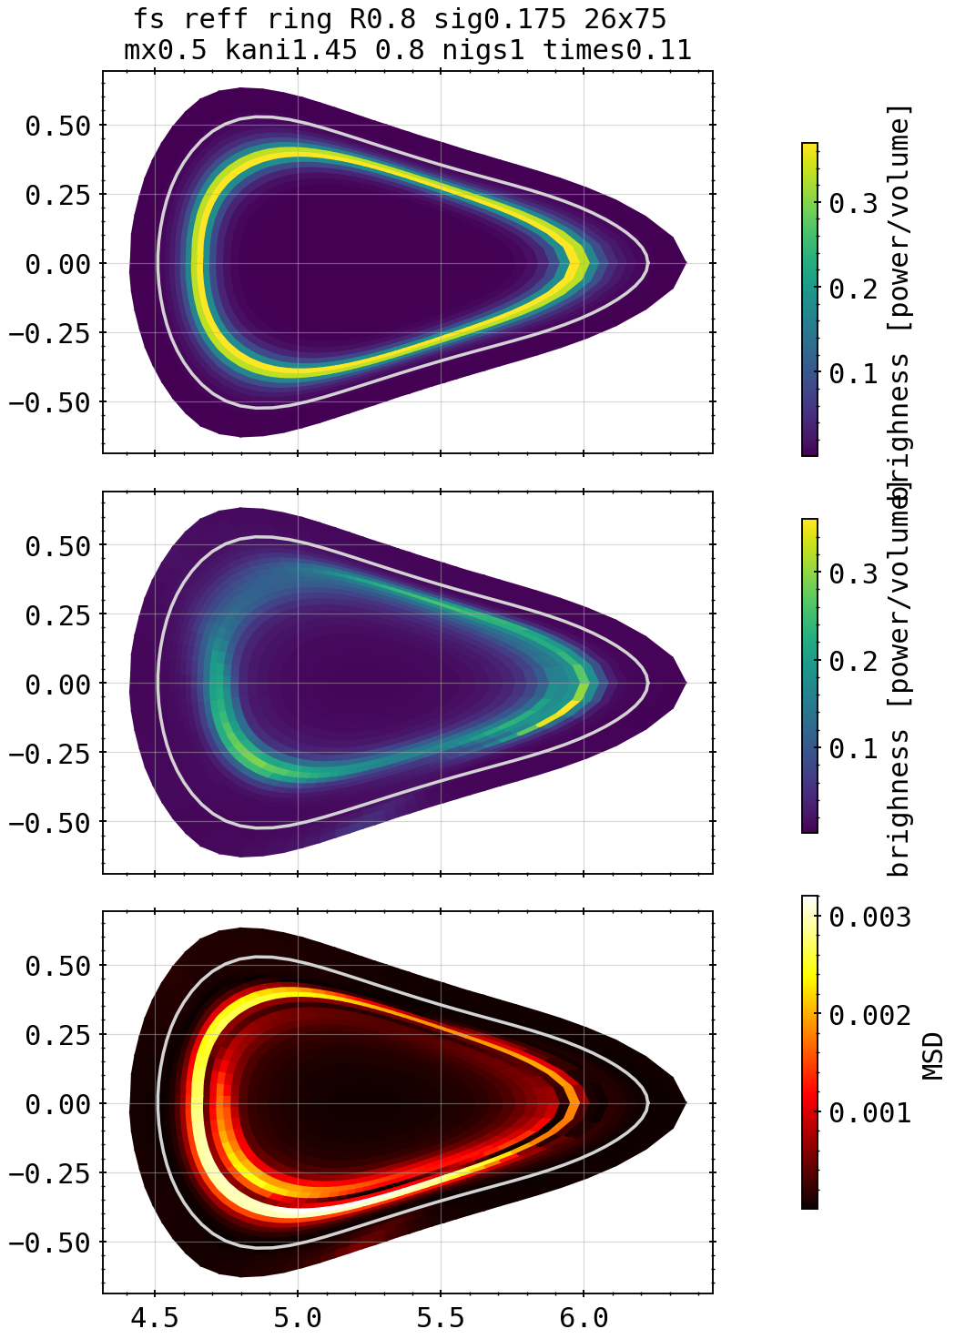

Phantoms: Ring inside LCFS Core Scan
1.35
1.5
X²=1.02
X²=1.01
Kcore=1.25, kdiff=0.8
1.4
1.55
X²=32.8
X²=1.0
X²=1.04
1.3
1.45
1.6
X²=1.84
X²=1.04
X²=1.21

Slide 12
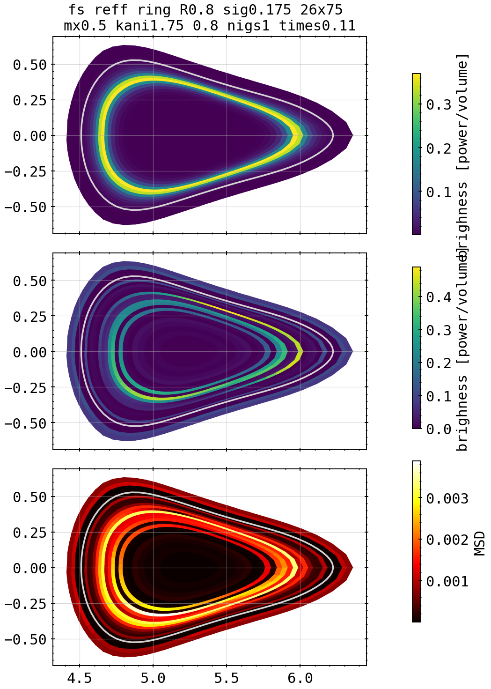
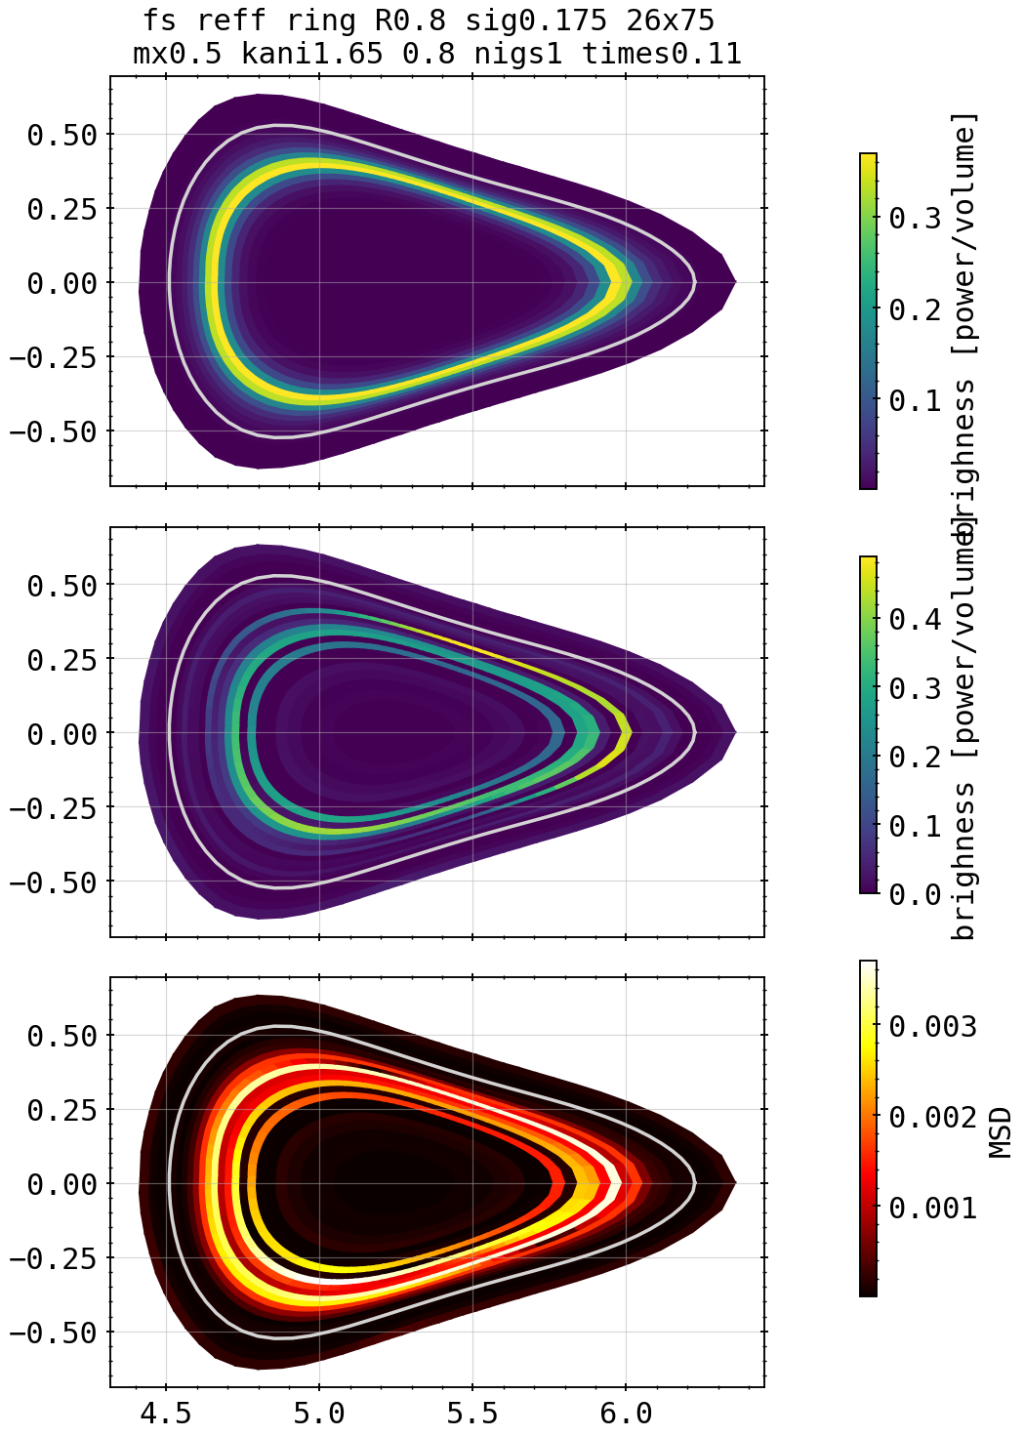
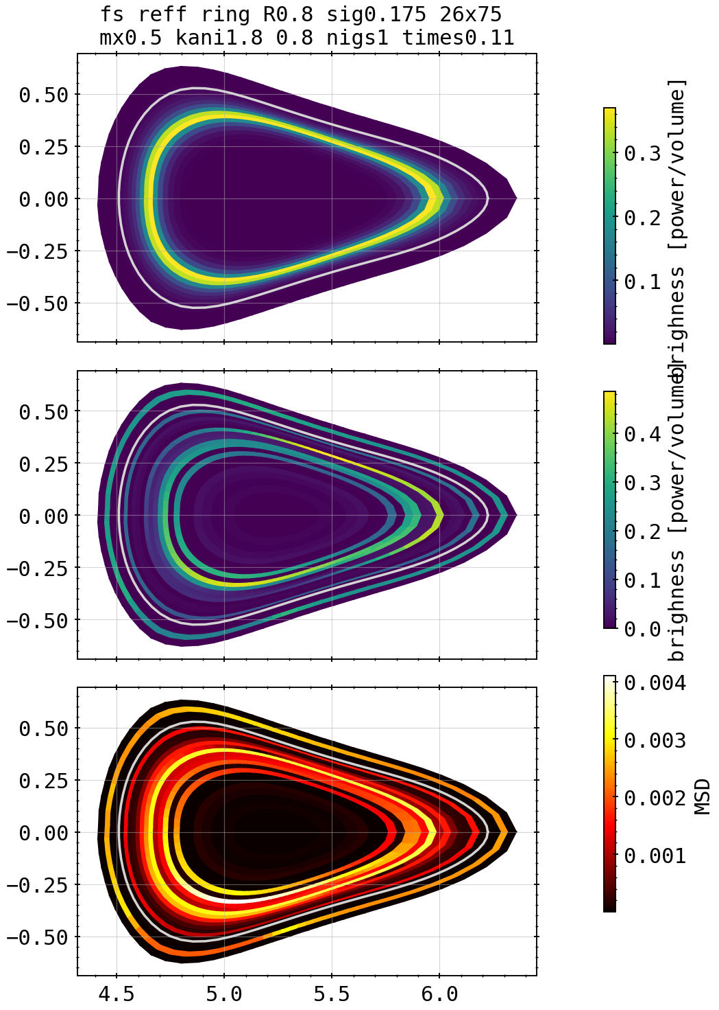
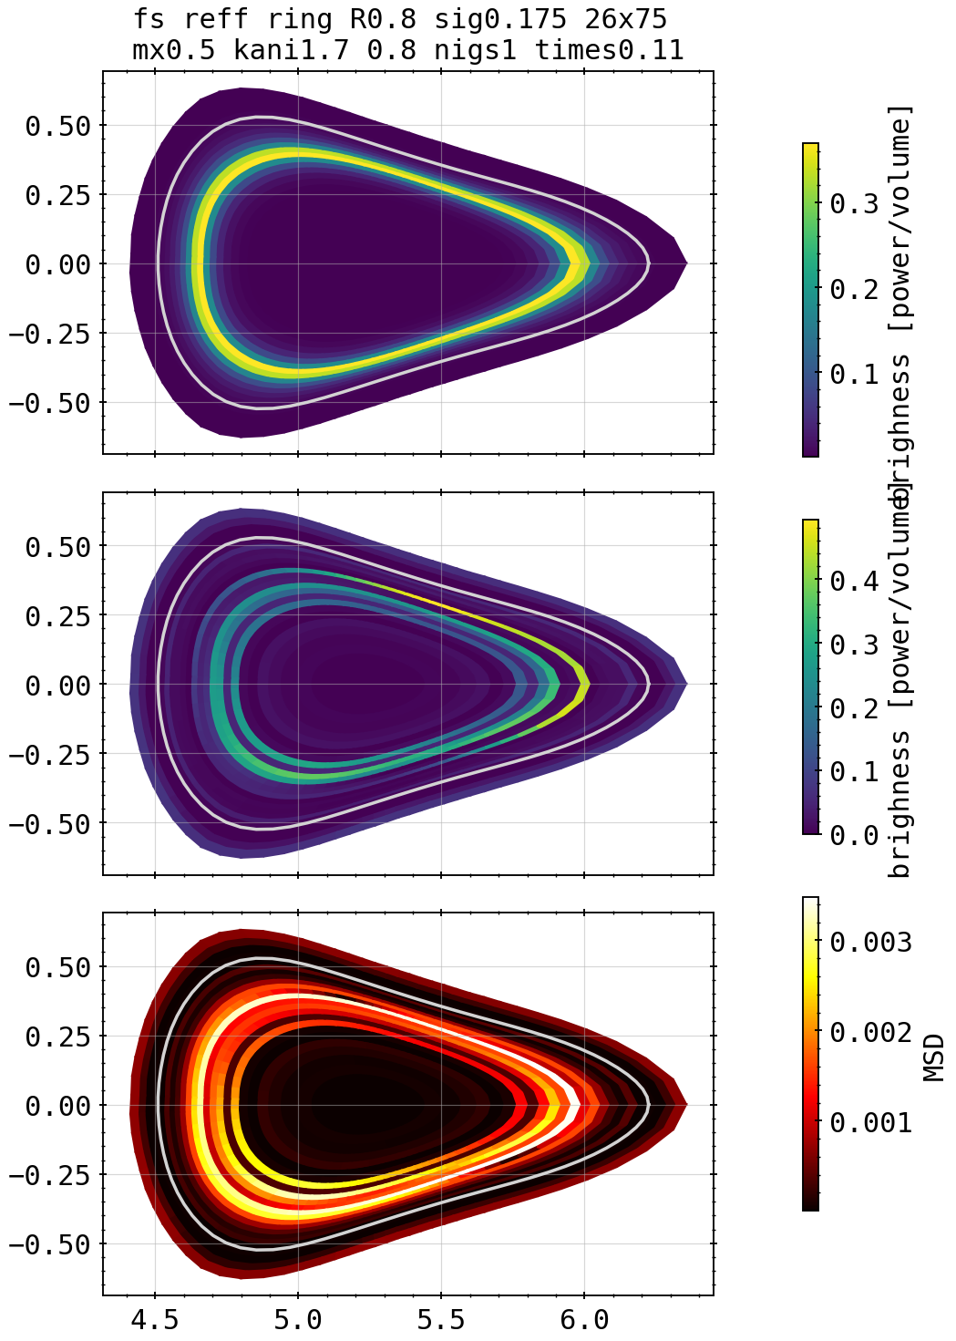
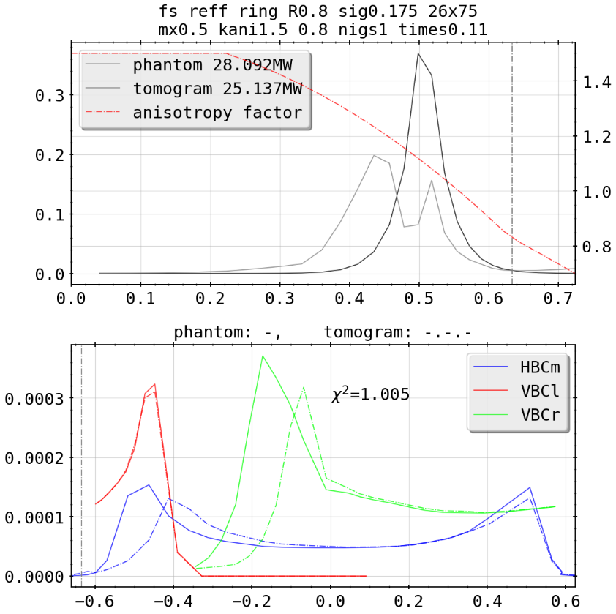
Phantoms: Ring inside LCFS Core Scan
1.75
Kcore=1.5, kdiff=0.8
X²=8.03
1.65
1.8
X²=1.44
X²=20.56
1.7
X²=2.51

Slide 13
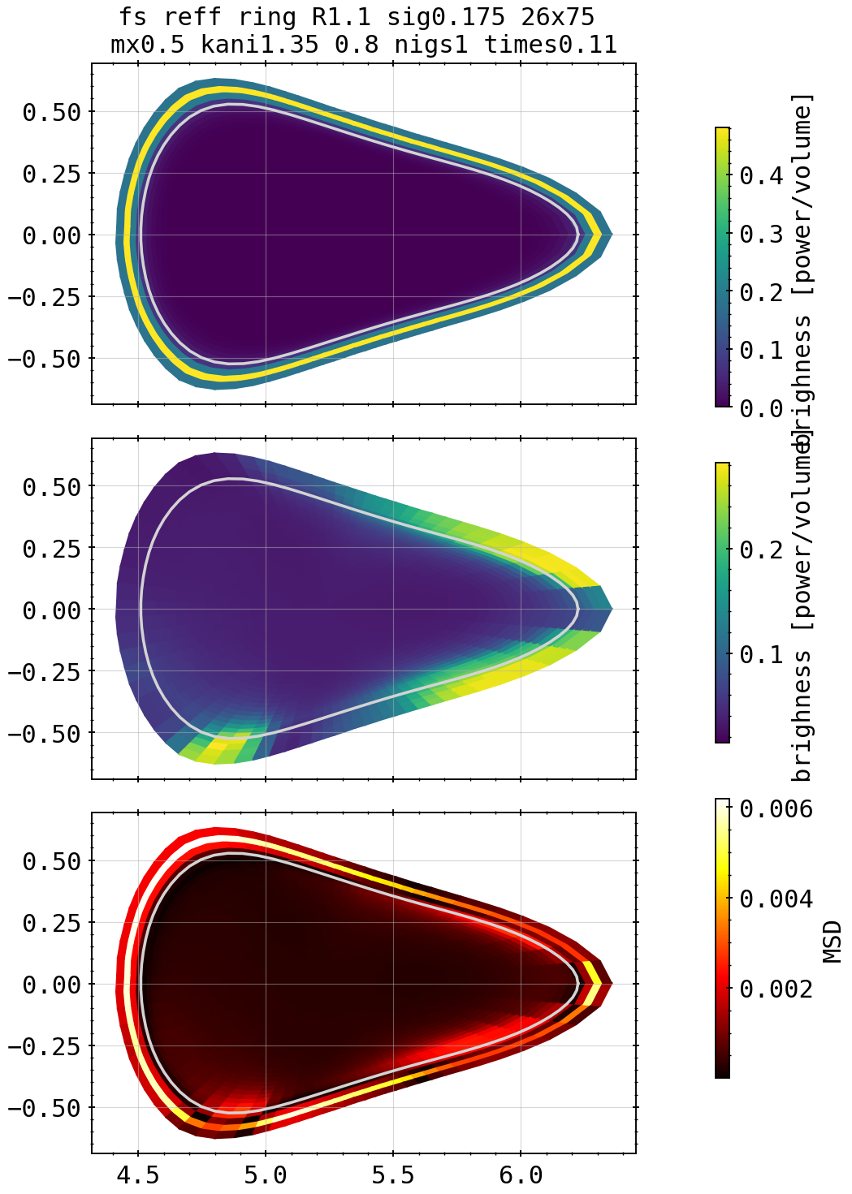
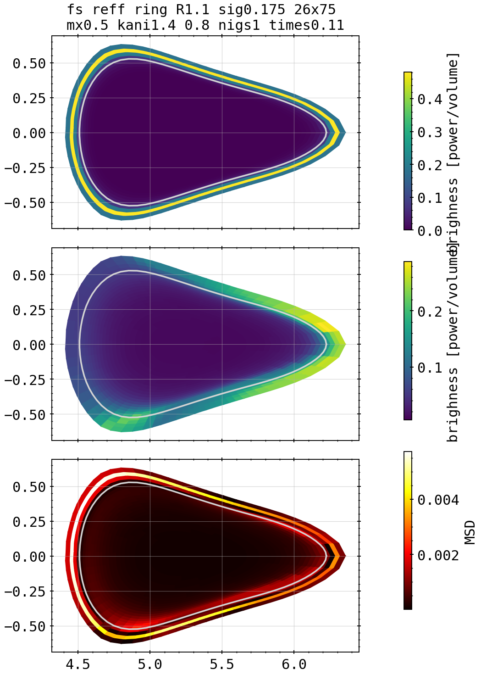
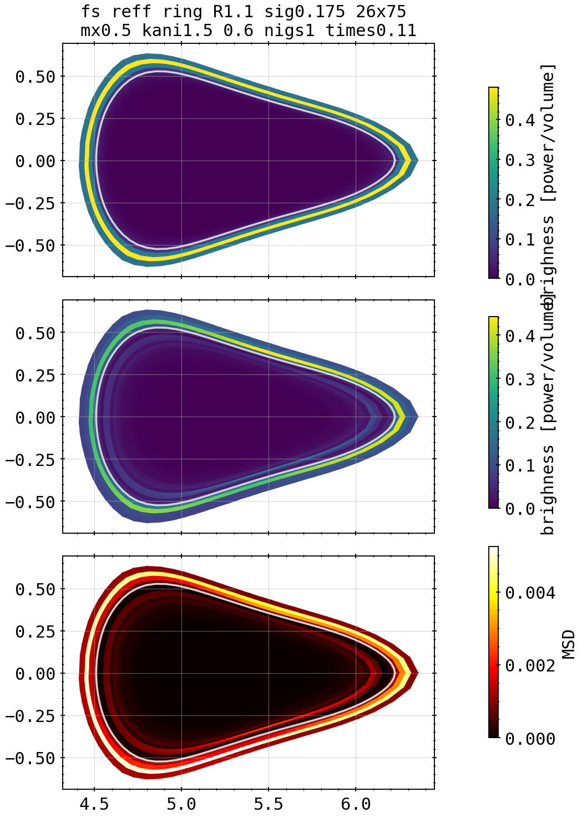
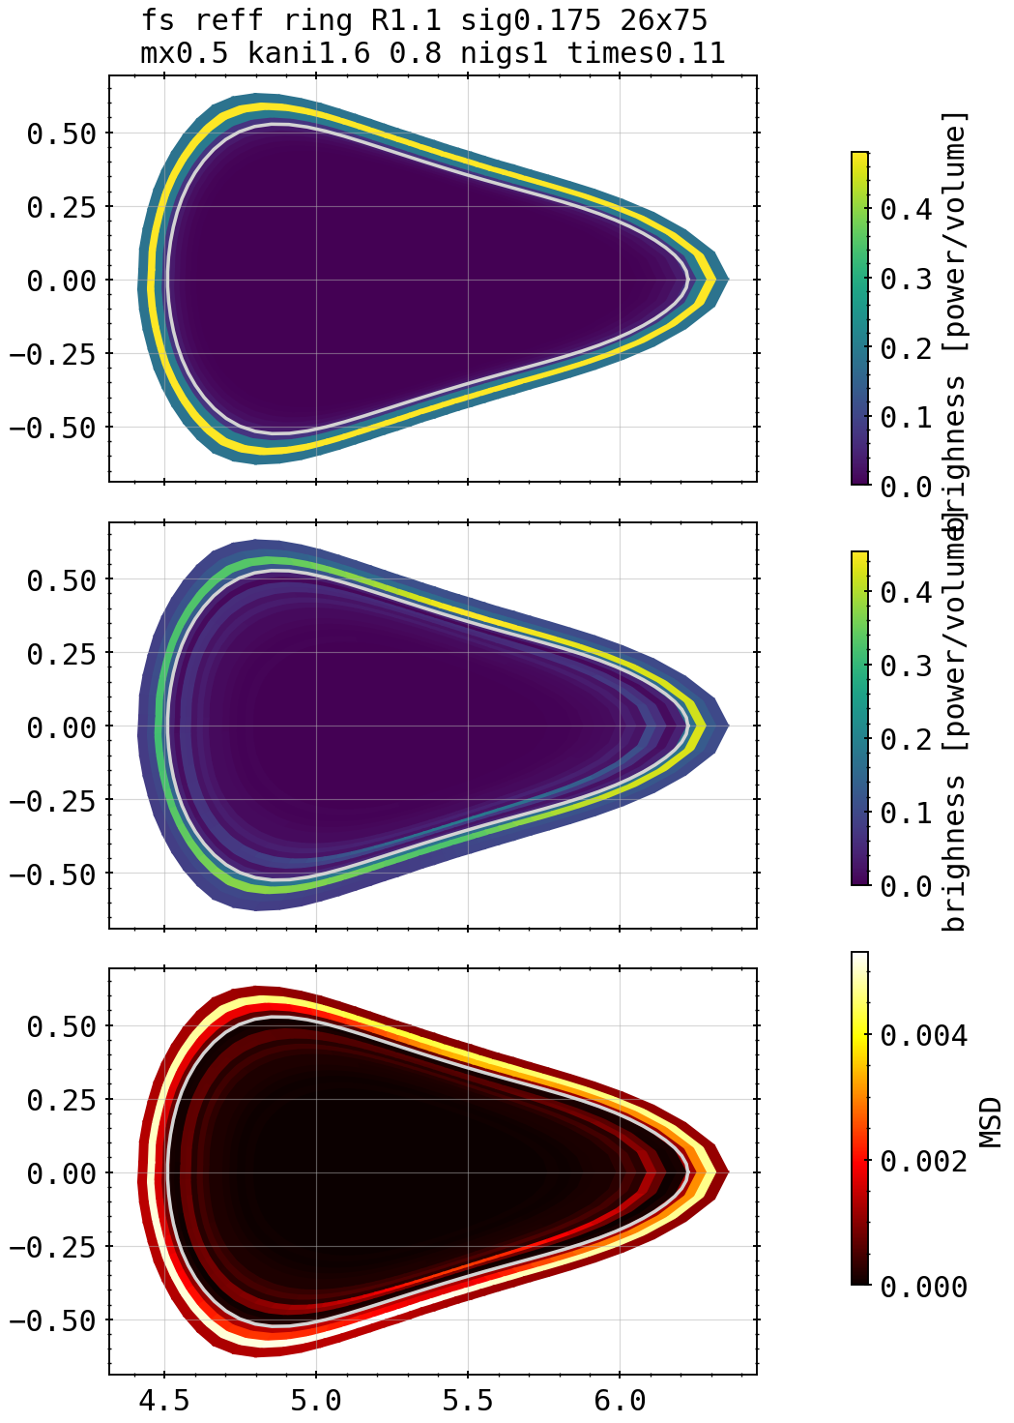
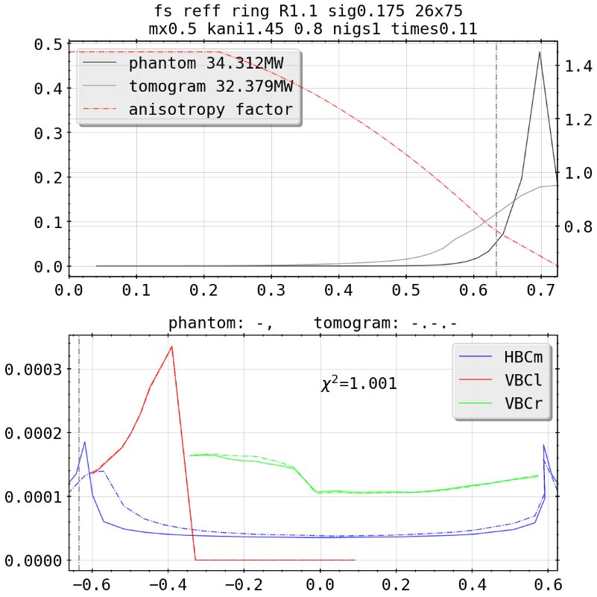
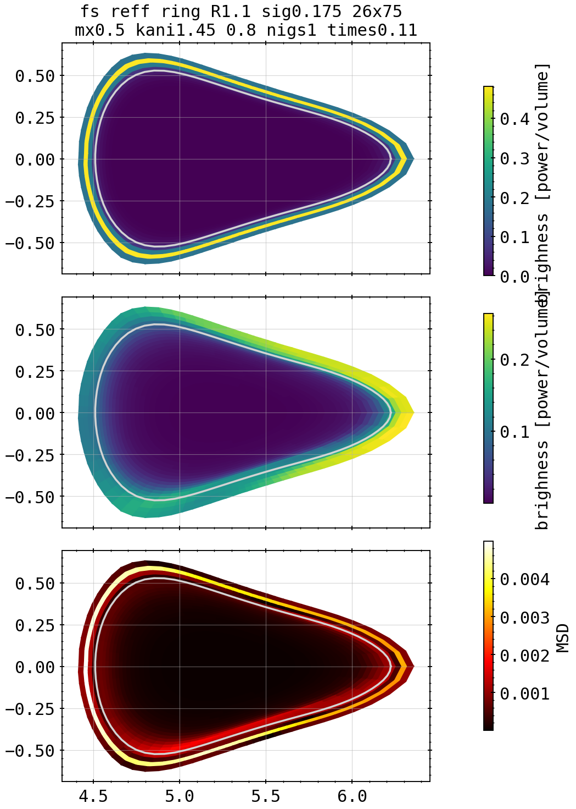
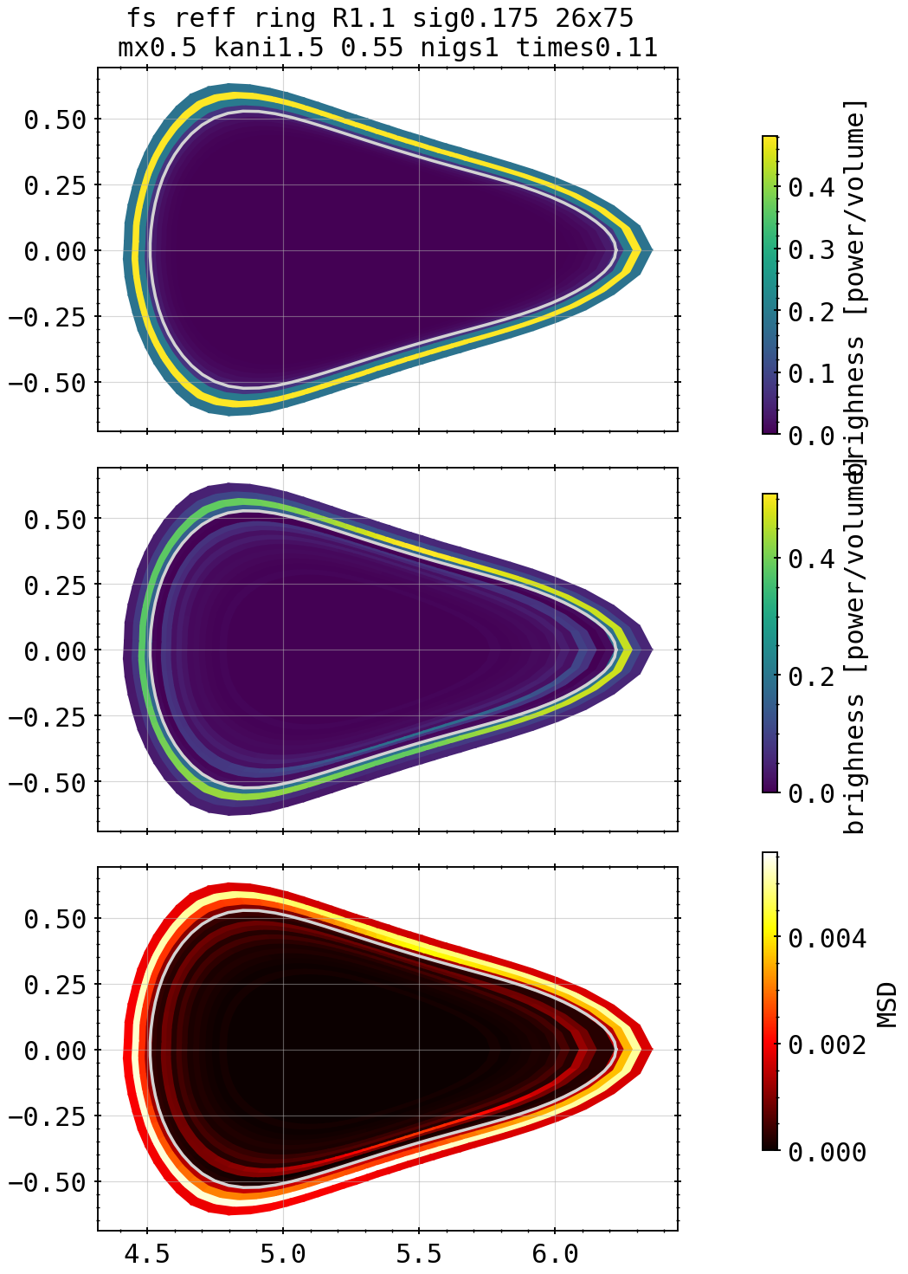
Phantoms: Ring outside LCFS Scan
Kcore=1.4, kdiff=0.8
Kcore=1.5, kdiff=0.6
X²=1.007
X²=1.012
Kcore=1.35, kdiff=0.8
Kcore=1.6, kdiff=0.8
X²=1.004
X²=1.012
Kcore=1.45, kdiff=0.8
Kcore=1.5, kdiff=0.55
X²=1.001
X²=1.038

Slide 14
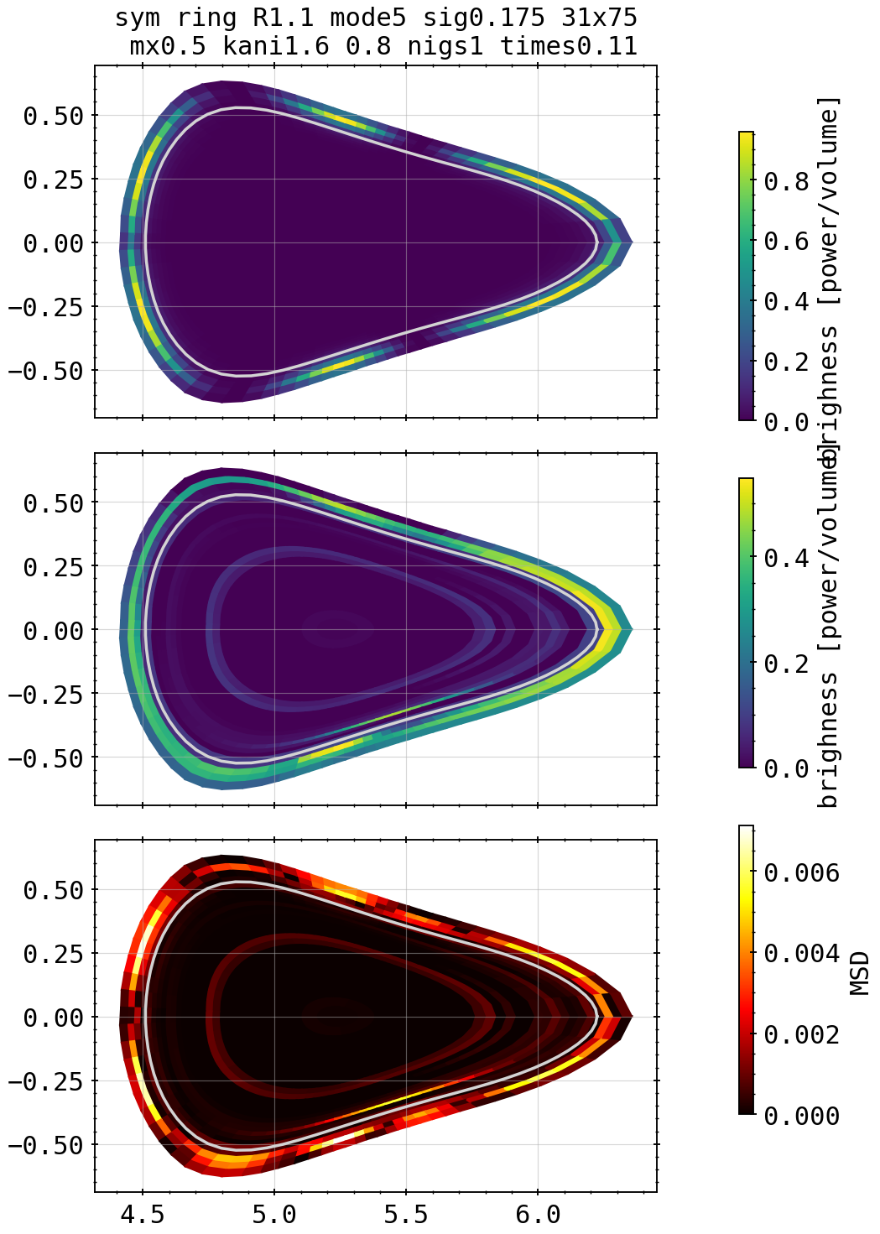
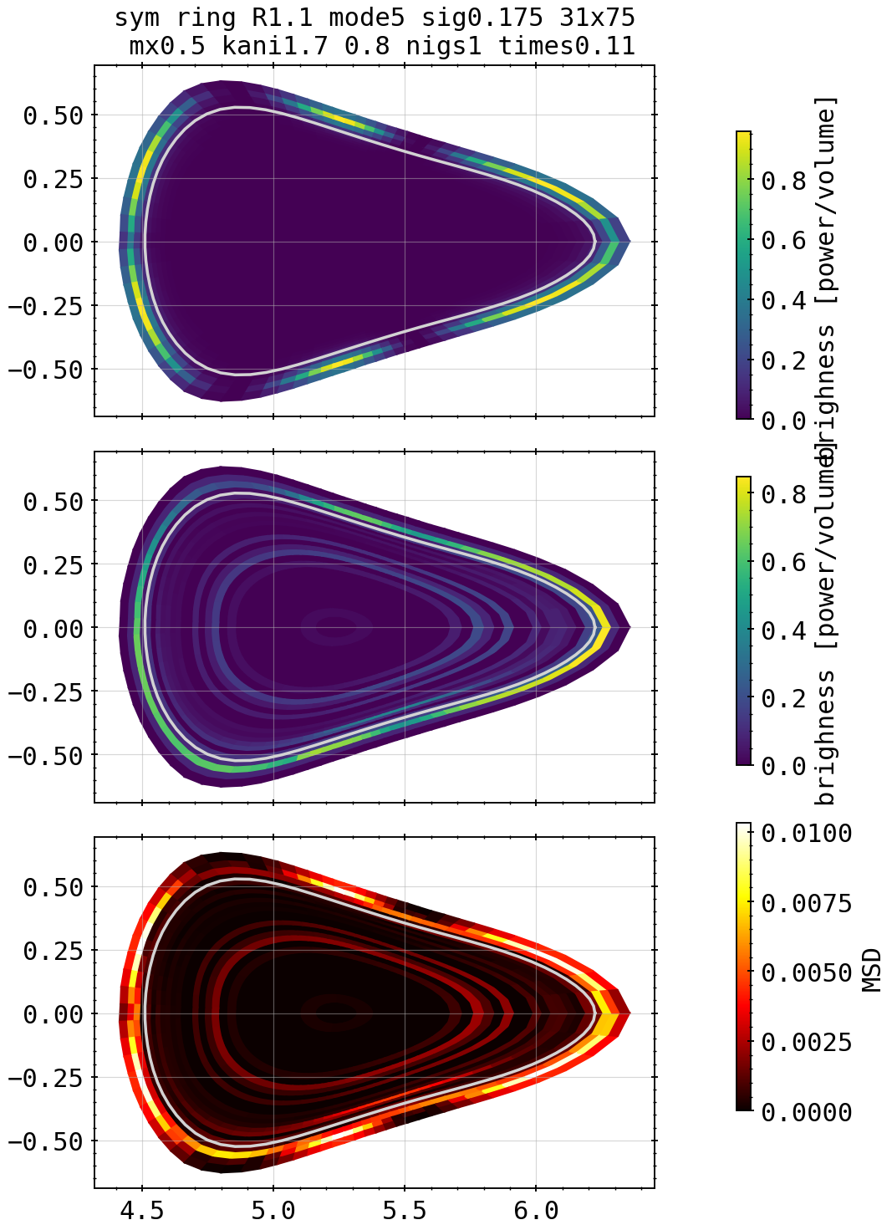
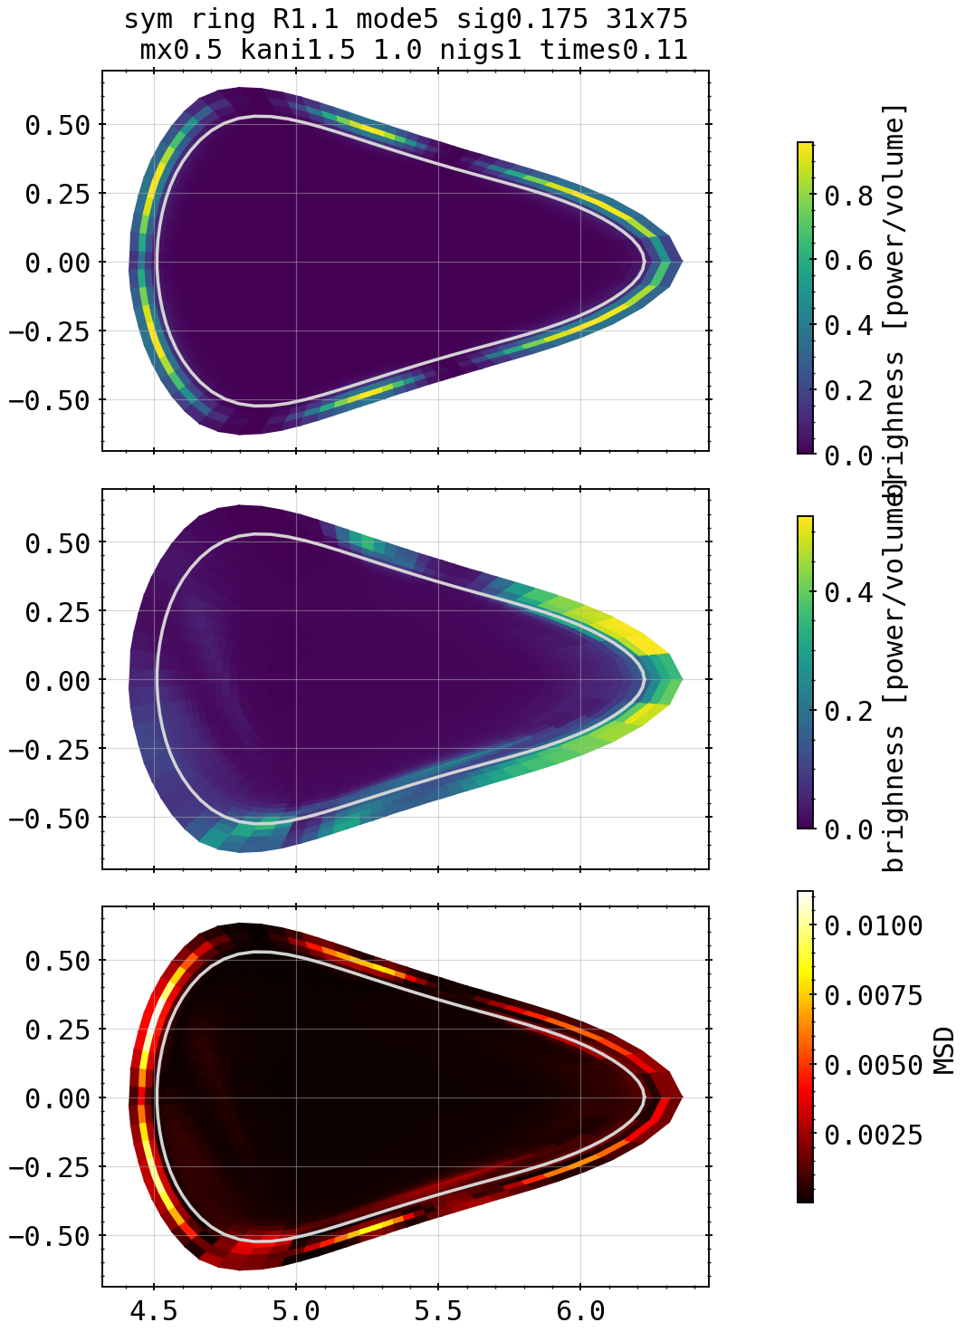
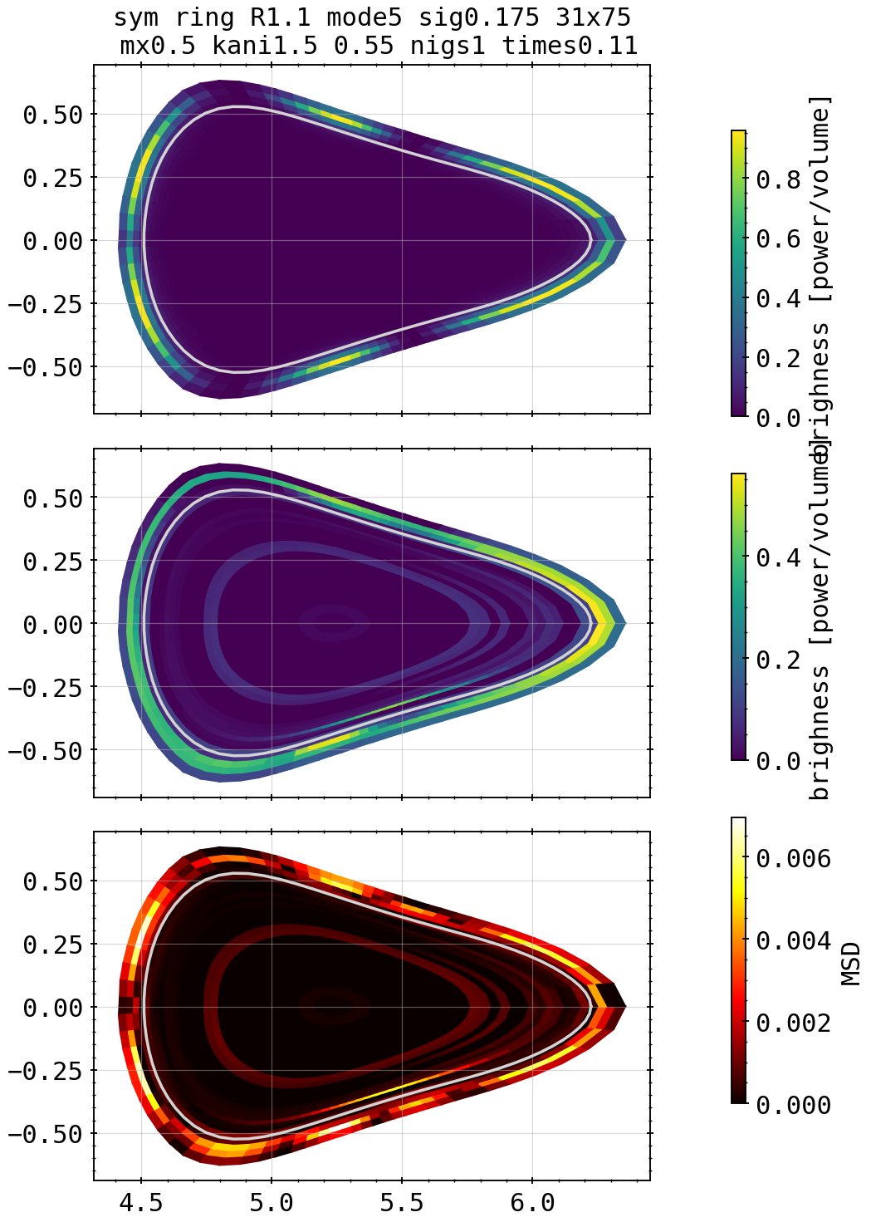
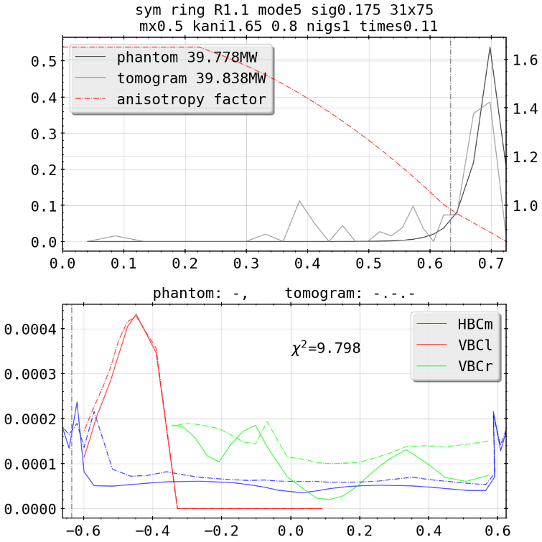
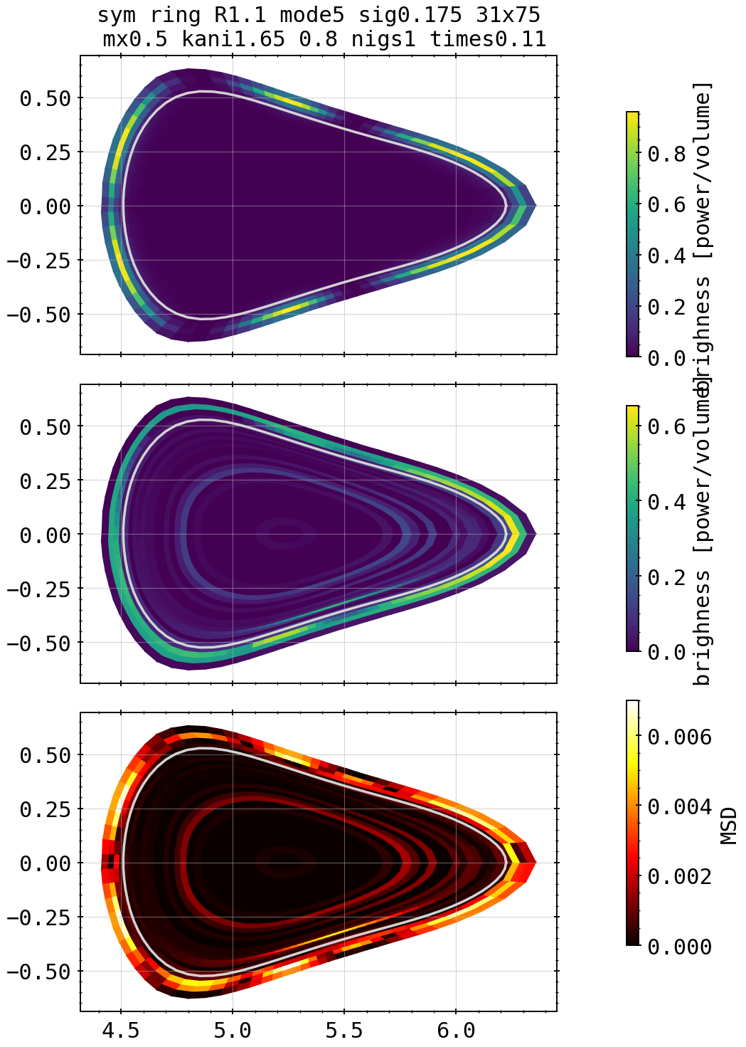

Phantoms: Island Mimic outside LCFS Scan
Kcore=1.7, kdiff=0.8
Kcore=1.5, kdiff=1.0
X²=19.38
X²=1.01
Kcore=1.6, kdiff=0.8
Kcore=1.5, kdiff=0.55
X²=9.79
X²=6.98
Kcore=1.65, kdiff=0.8
Kcore=1.5, kdiff=0.6
X²=6.208
X²=6.16

Slide 15
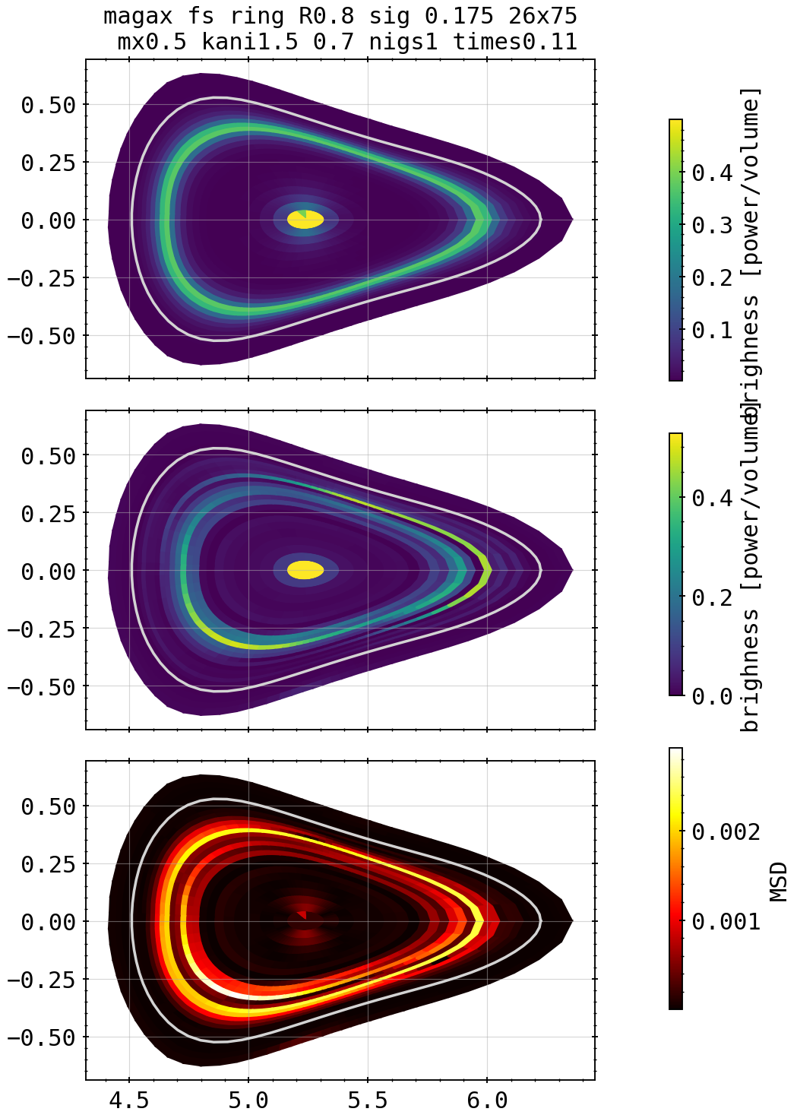
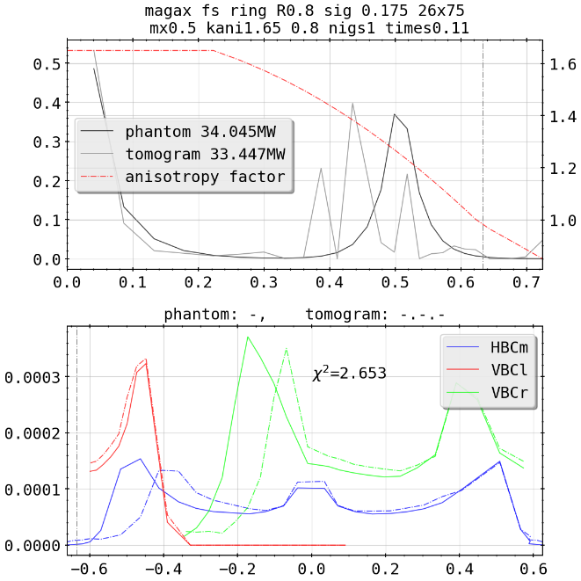


Phantoms: Combinations

Slide 16




Phantoms: Combinations
X²=4.87
X²=5.56

Slide 17




Phantoms: Combinations

Slide 18



Revisited: Cartesian Test, No Anisotropic Weighting

Slide 19

Revisited: Cartesian Test, No Anisotropic Weighting

Slide 20


STRAHL Profiles and 20181010.032 Feedback Discharge
frad=33%
X²=94.85
X²=1.43

Slide 21


STRAHL Profiles and 20181010.032 Feedback Discharge
frad=66%
X²=2218
X²=1. 01

Slide 22


STRAHL Profiles and 20181010.032 Feedback Discharge
frad=90%
X²=2245
X²=1.05

Slide 23


STRAHL Profiles and 20181010.032 Feedback Discharge
frad=100%
X²=4705
X²=1.009

Slide 24













Revisited: Test of 20180725.044
KJM magnetic configuration
chordal profile HBCm

Slide 25

Revisited: Test of 20180725.044
KJM magnetic configuration
chordal profile HBCm

Slide 26
Revisited: Test of 20180725.044
KJM magnetic configuration
chordal profile HBCm

Slide 27
Revisited: Test of 20180725.044
KJM magnetic configuration
chordal profile HBCm

Slide 28
Revisited: Test of 20180725.044
KJM magnetic configuration
chordal profile HBCm

Slide 29
Revisited: Test of 20180725.044
KJM magnetic configuration
chordal profile HBCm

Slide 30
Revisited: Test of 20180725.044
KJM magnetic configuration
chordal profile HBCm

Slide 31
Revisited: Test of 20180725.044
KJM magnetic configuration
chordal profile HBCm

Slide 32
Revisited: Test of 20180725.044
KJM magnetic configuration
chordal profile HBCm

Slide 33
Revisited: Test of 20180725.044
KJM magnetic configuration
chordal profile HBCm

